Slide 1

Risk Analysis for GST Enforcement
Presentation by the Directorate General of Analytics & Risk Management
National Conference of Enforcement Chiefs of State & Central GST 04.03.2024

Slide 2
Risk Analysis : Beginnings
New Registration Taken
Return Filing Cycle
(GSTR-1/3B) Initiated
Mismatch in
2A-3B, 1-3B, etc.
List of risky taxpayers shared for verification
Analysis
based on
Identification of
e-way bill
………………….
……………….
GST returns
data
Risky Taxpayers
Fraud identified after the returns are filed.
Significant fake ITC gets generated and layered in the intervening period
Fake registrations gets identified only in conjunction with fraud detection post return filing

Slide 3
New approach to Risk Analysis : ANVESHAN
New Registration Taken
Registration documents,
E-way bills, VAHAN / Fastag data
ANALYSIS
on the data prior
to the Return Filing Stage
List of risky taxpayers shared for verification
Identification of
Risky Taxpayers
In addition to existing risk management approach, new approach is to advance the risk analysis before return cycle and to make it
pinpointed and actionable.

Slide 4
ANVESHAN- Actionable Intelligence
Single point identification of entire risky supply chain networks
Removing constraints of Jurisdiction/Human resources for speedy and efficient enforcement
Targeting fake and fraudulent ITC
Detecting anomalous behaviour of new registrants
Analysis of EWB linked with FASTag data
Zeroing in on ultimate beneficiary

Slide 5
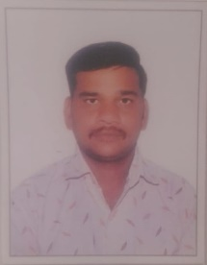
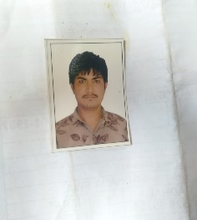
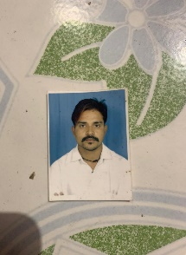


ANVESHAN : Anomalies in Digital Information
Exercise to weed out fake registration
Analysis of registration documents in the time window between registration and kicking in of returns cycle
PAN: CAAPV0024M
Illustration-I
24CAAPV0024MIZT
Vaghela Akash Harsukhbhai
Vaghela Traders
36CAAPV0024MIZO
Vaghela Akash Harsukhbhai
Ever Star Enterprise
33CAAPV0024MIZU
Vaghela Akash Harsukhbhai
V K Enterprise
27CAAPV0024MIZN
Vaghela Akash Harsukhbhai
V A Enterprise
24CAAPV0024M2ZS
Vaghela Akash Harsukhbhai
Tradillion & Store

Slide 6
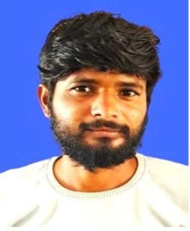
Illustration-II
PAN: LHEPS1418N
GSTIN 09LHEPS1418N1ZN
Solanki Mukesh : Kushwaha Ent.
PAN : GKRPS4027N
GSTIN: 33GKRPS4027N1ZE
: SV Jasvantbhai
Shah Enterprise
PAN : DOPPG3692A
GSTIN: 27BOPPG3692A1ZU
MP Gaekwad
Tirupati Enterprise
PAN:GAOPP7529B
GSTIN 14GAOPP7529B1ZH
PV Karshanbhai,
Mayadevi Ent.
Outcomes:
Registration Months | GSTINs shared | No. of GSTINs Verified | No of GSTINs found fake/non-existent | Percentage
Oct/Nov 2023 | 438 | 286 | 259 | 90%

Slide 7
ANVESHAN – Early Warning Series
Exercise to identify New Registrants with propensity to generate fake ITC
Analysis of EWB/FASTag data in the time window between registration and kicking in of returns cycle
PoC undertaken for New Registrations obtained in February 2024
Analysis conducted in third week of Feb
Actionable input shared with Field on 28.02.2024

Slide 8
Illustration
Mewara Traders
Regn: 7.2.2024
Outward supply : 1.9 cr. in 15 days
Inward supply : 0.2 cr.
5. Verification: Non existent
Outcome:
 | GSTINs shared | No. of GSTINs Verified | No of GSTINs found fake/Non-existent | Percentage
Centre | 19 | 16 | 16 | 100%
State | 13 | 1 | 1 | 100%
Total | 32 | 17 | 17 | 100%

Slide 9

Moving Ahead…
Inputs to the field have yielded encouraging results
Suggestions from field formations will help in refining the risk analysis.
The directorate is working to automate and scale up the process of generation of these reports.
This will ensure more detections and faster dissemination of inputs to field formations.

