Slide 1
ADVAIT-Advanced Analytics in Indirect Taxation
Directorate General of Systems & Data Management
Leveraging Technology for Serving Taxpayers
Notes:
ADVAIT is the Business Intelligence platform of CBIC which leverages the capabilities of Artificial Intelligence (AI) and Machine Learning (ML) to extract better insights from data for Enhancing Indirect Tax Revenue, Increasing Taxpayer base and supporting Data-Driven tax policy formulation

Slide 2
ADVAIT Features
Analytics on GST
State of Art Data Visualization
Near real time Data Capture and Exchange
Predictive & Fraud Analytics
Big Data
Data Science Lab
Access on Mobile Devices
Enhanced Self Service BI
Network Analytics
Pattern recognition
360 degree Entity Profiling
Text Mining, Forecasting, Data Matching

Slide 3
ADVAIT Business Output –Live Functionalities
Reports
30
Dashboards
50+
Analytical
Models
450+
E&O Phase
Development Phase
Total Count

Slide 4
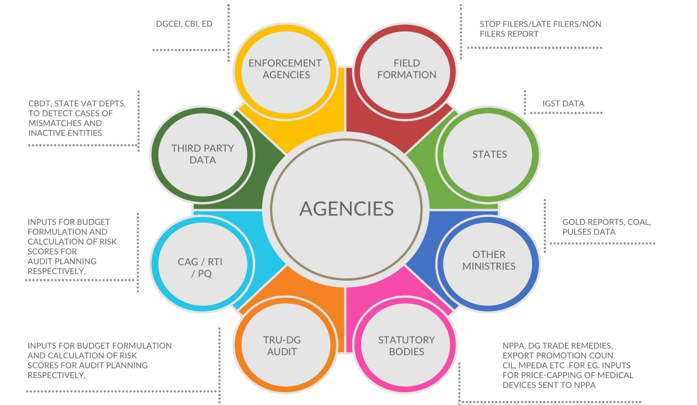
ADVAIT Users
Reports to DGGI, CBI, ED, SFIO, NCB
Reports to
DAY TO DAY REQUESTS, ADHOC REPORTS,
SFIO,NCB
Data requests
CBDT, NATGRID
GOLD, COAL, PULSES, FERTILIZERS DATA
Data shared with CAG and for RTIs and PQs
INPUTS FOR BUDGET FORMULATION, CALCULATION OF RISK SCORES FOR AUDIT PLANNING AND TAX POLICY FORMULATION
GOVT.
REGULATORY
AGENCIES
NPPA, DG TRADE REMEDIES, DCGI, e.g., INPUTS FOR PRICE-CAPPING OF MEDICAL DEVICES SENT TO NPPA

Slide 5
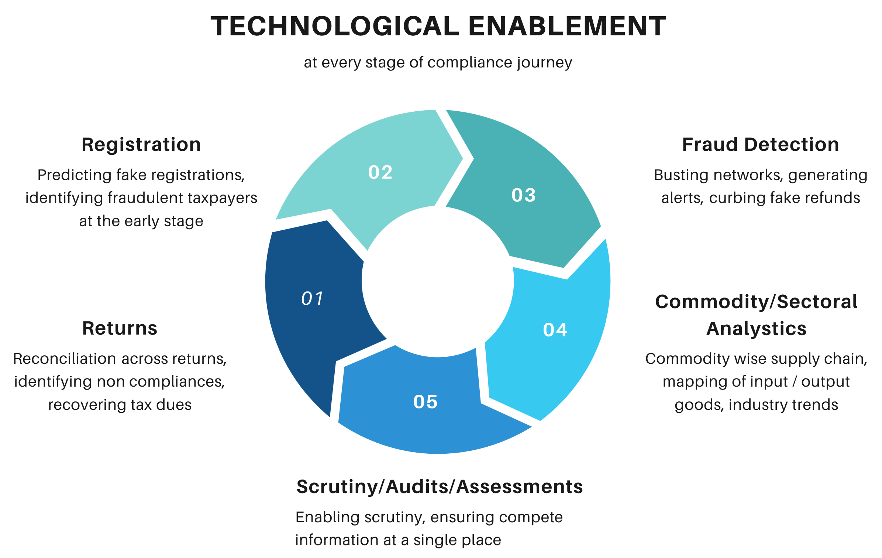
Technological Enablement

Slide 6
GST Dashboards

Slide 7
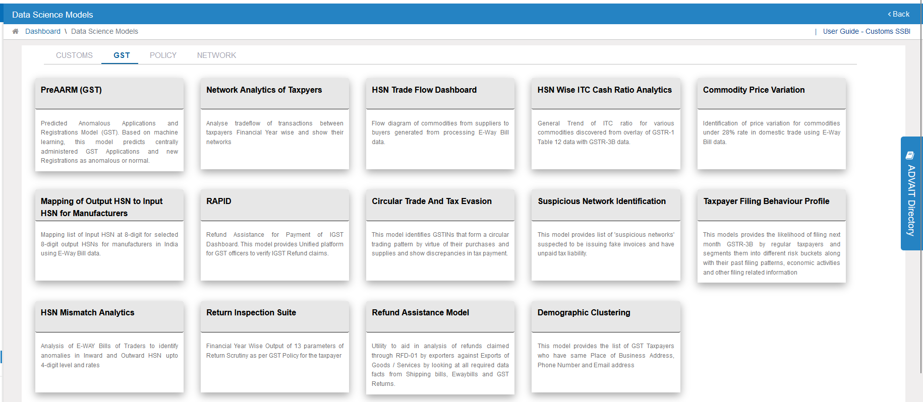
GST Data Science Models

Slide 8
GST Reports
Category | Count
Registration | 12
Returns | 16
ITC | 14
Turnover | 19
Tax Payment | 19
Miscellaneous | 6
Category | Count
E-Way bills | 7
Summarized | 5
HSN | 6
Refund | 4
Audit | 2
Range | 19

Slide 9
Registration

Slide 10
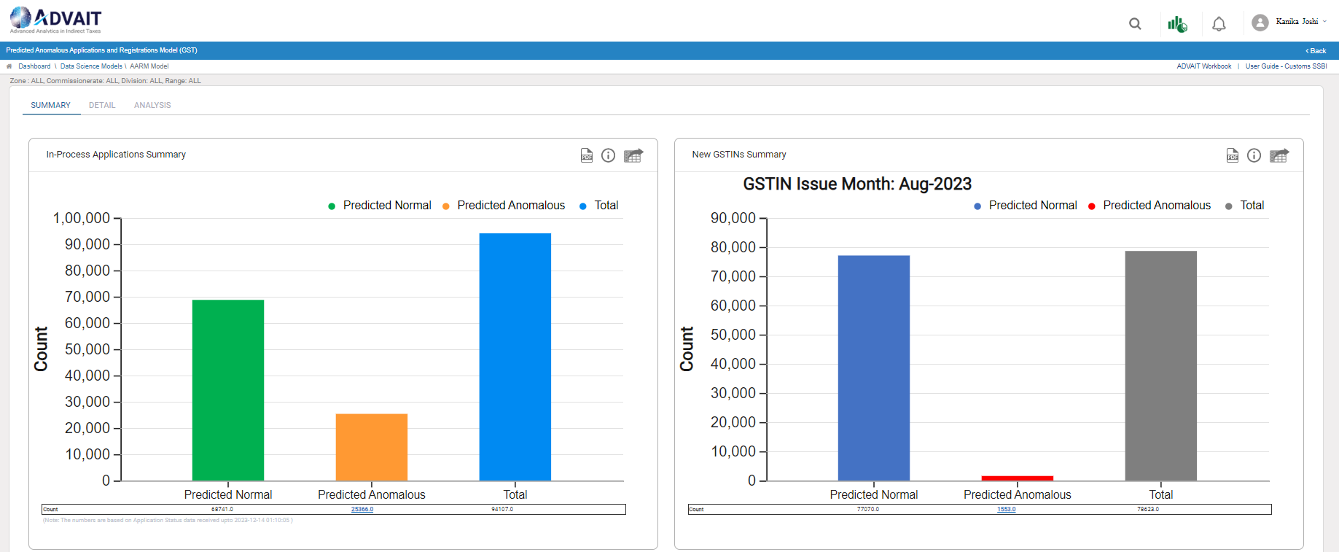
Pre AARM
Notes:
Predicts the probable fraudulent GSTINs at the time of registration application which may enter the GST landscape and generate fake ITC or obtain refund in the coming period

Slide 11
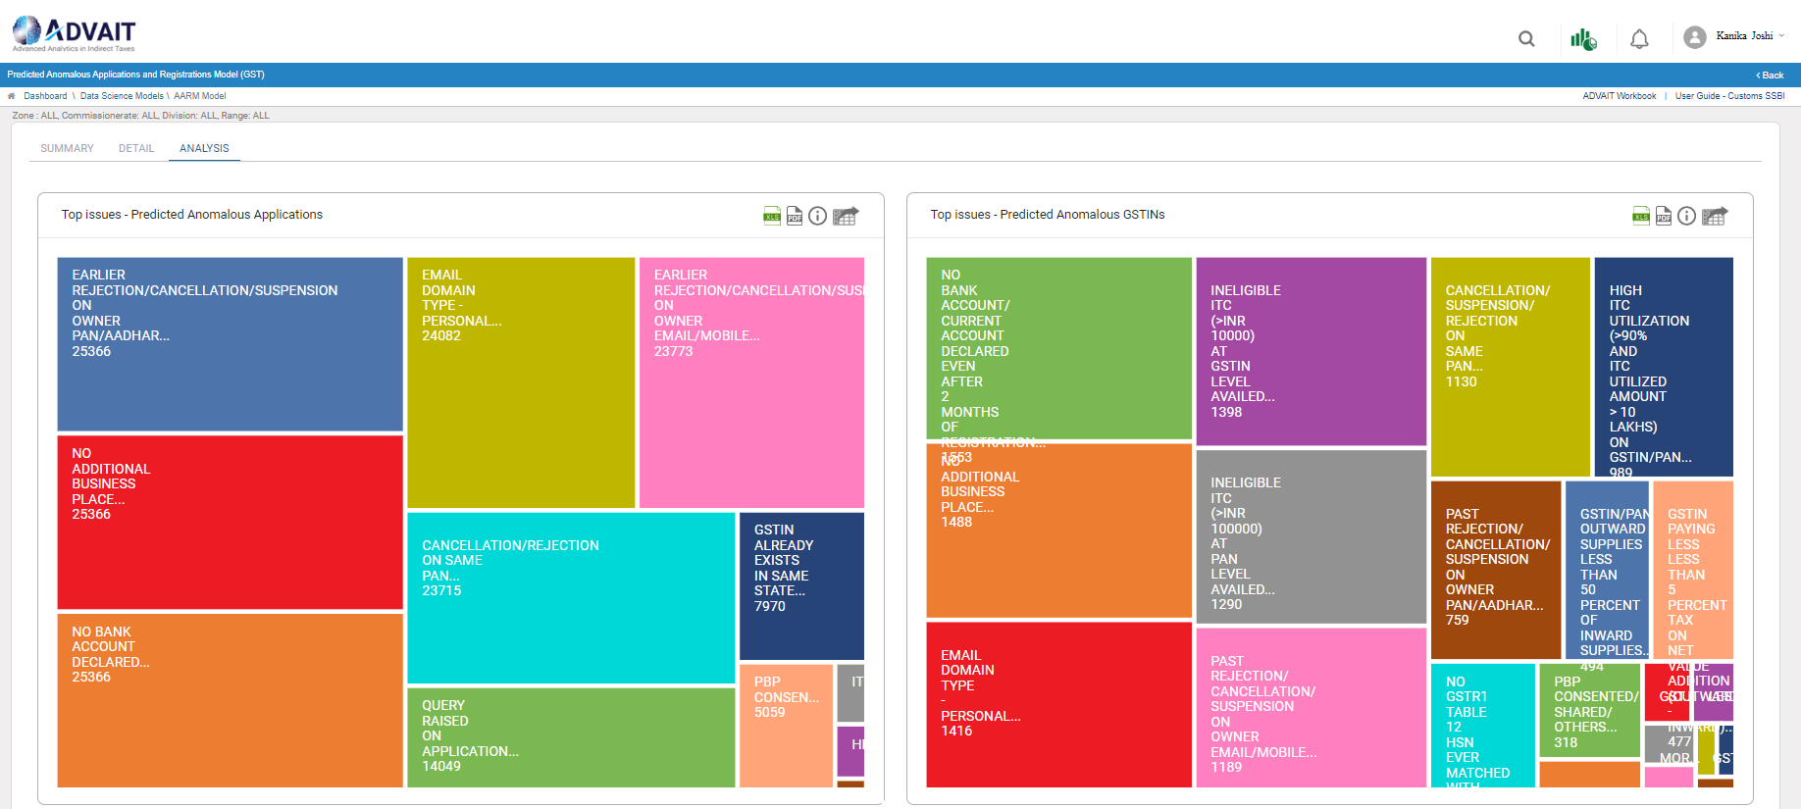
Pre AARM
Notes:
It lays down the topmost reasons for prediction of any registration application or GSTIN as the fraudulent one. All these results have been identified by the system using the machine learning techniques on the historical data and then applying it on the future applications

Slide 12
New registrants with significant turnover as per GSTR-3B and E-way bill
Notes:
It is essential to catch and curb the tax frauds at the earliest possible. This report helps in identifying the taxpayers who are reporting substantial turnover in the initial 3 or 6 months or their existence

Slide 13
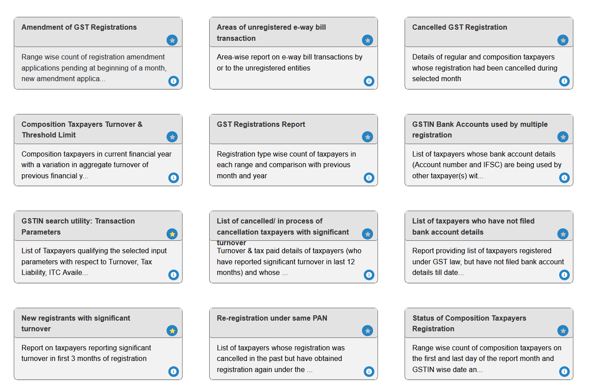
Registration related reports
Notes:
We have a complete set of reports around registration which help the officer in monitoring the taxpayers in their jurisdiction

Slide 14
Returns

Slide 15
Analytical Reports on Returns
Notes:
Using the returns data, ADVAIT provides various analytical reports which include but limited to identifying mismatches across returns, reversal of ITC, interest and late fee recoverable etc.

Slide 16
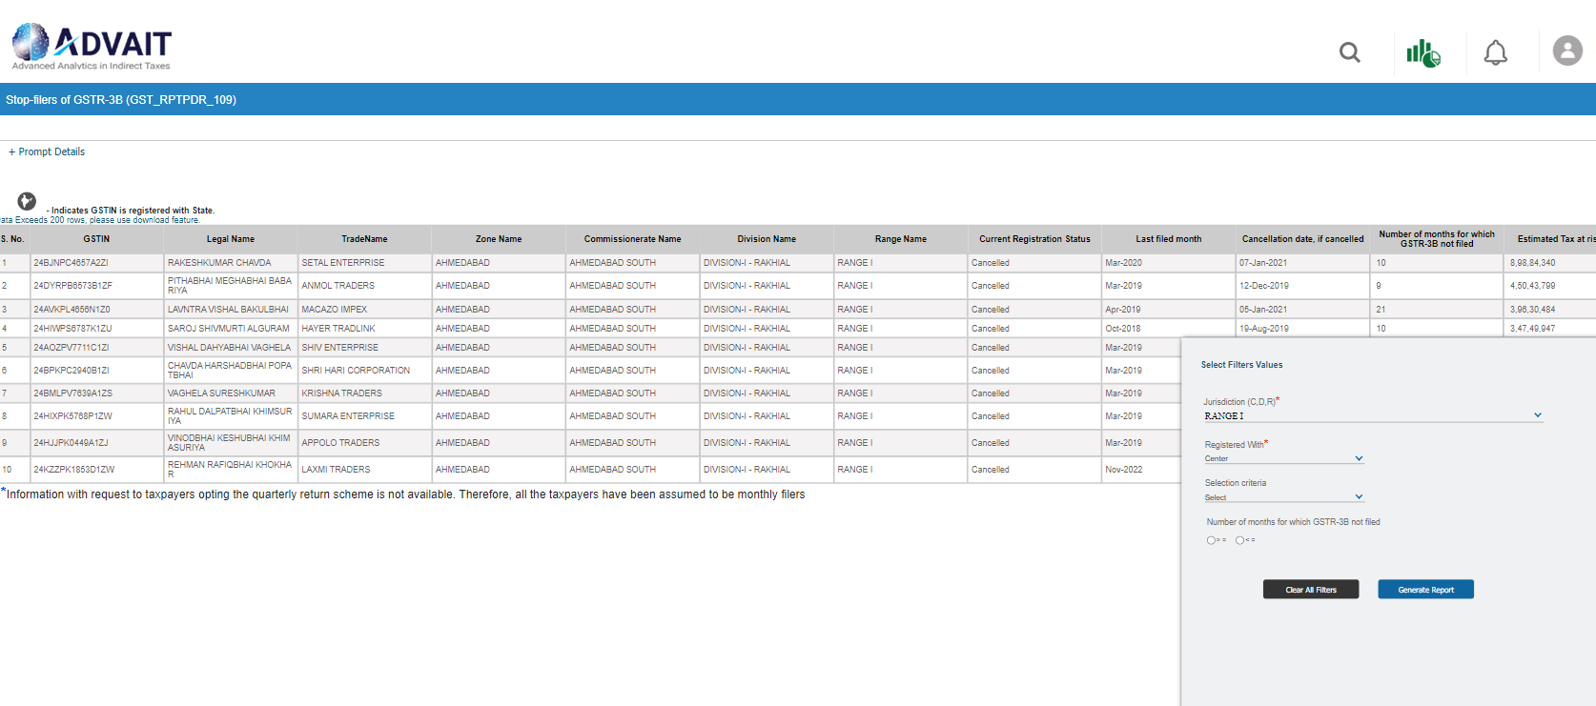
Stop-Filer report
Notes:
It provides the list of taxpayers who have stopped filing the returns along with their probable tax liability for the non-filed months

Slide 17
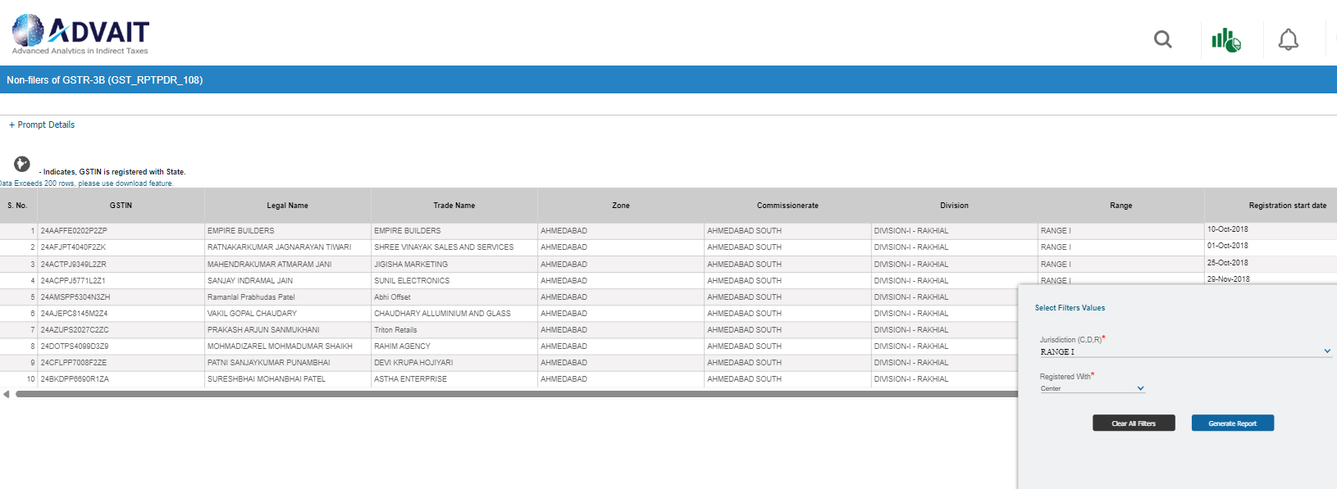
Non-Filer report
Notes:
This provides the list of taxpayers who not filed even a single return post their registration

Slide 18
For Fraud Detection

Slide 19
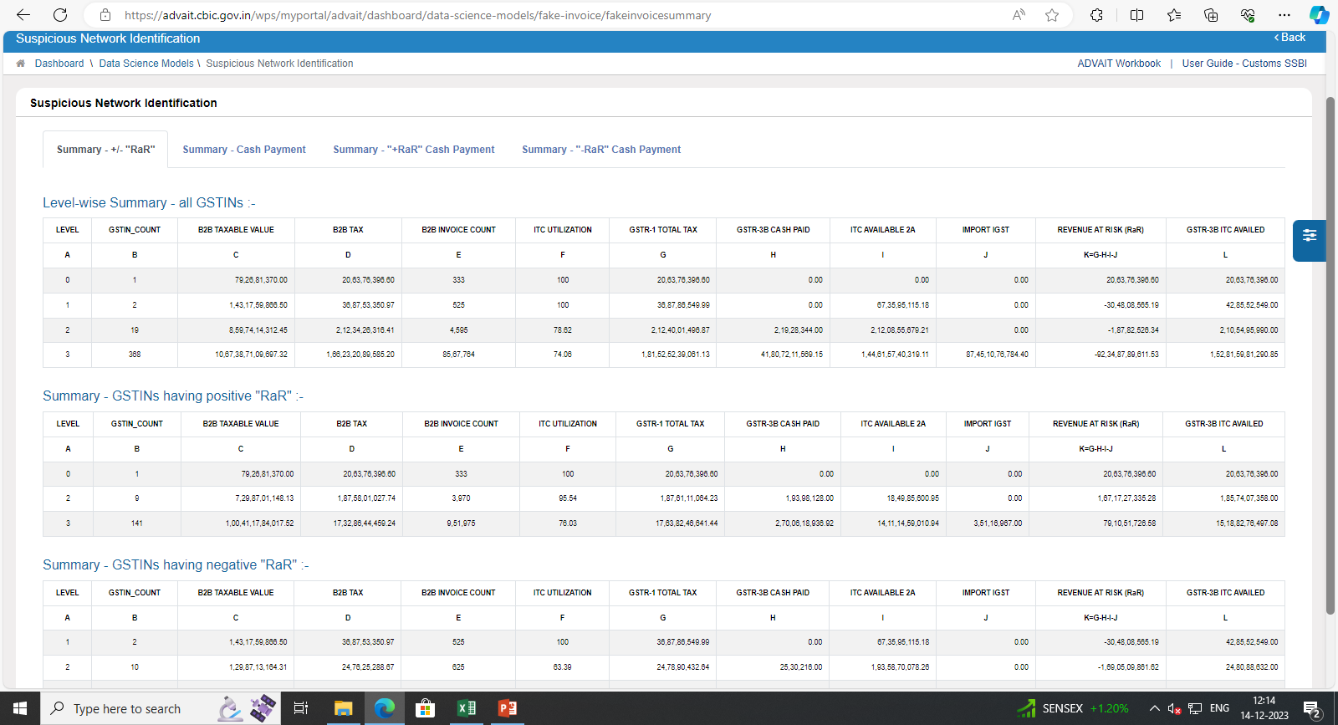
Suspicious network / Network analytics
Notes:
Provides the complete network of buyers and suppliers of taxpayers generating fake ITC into the system, their total invoice count, tax paid, ITC passed and Revenue at risk

Slide 20
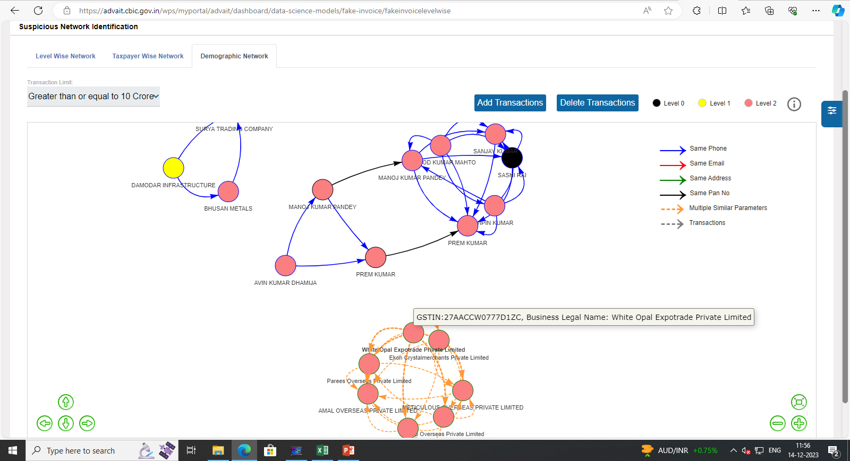
Suspicious network / Network analytics
Notes:
It provides the graphical representation of suspicious networks and also highlighting their demographic connections using various parameters such email id, phone number, address etc.

Slide 21
Circular Trade
Notes:
It displays the network of taxpayers which are involved in circular trading consisting of 2 or more GSTINs. Like in this example, there is a network of 7 taxpayers indulging in circular trade. The objective here may be to inflate the turnover or routing the unutilized or ineligible ITC

Slide 22
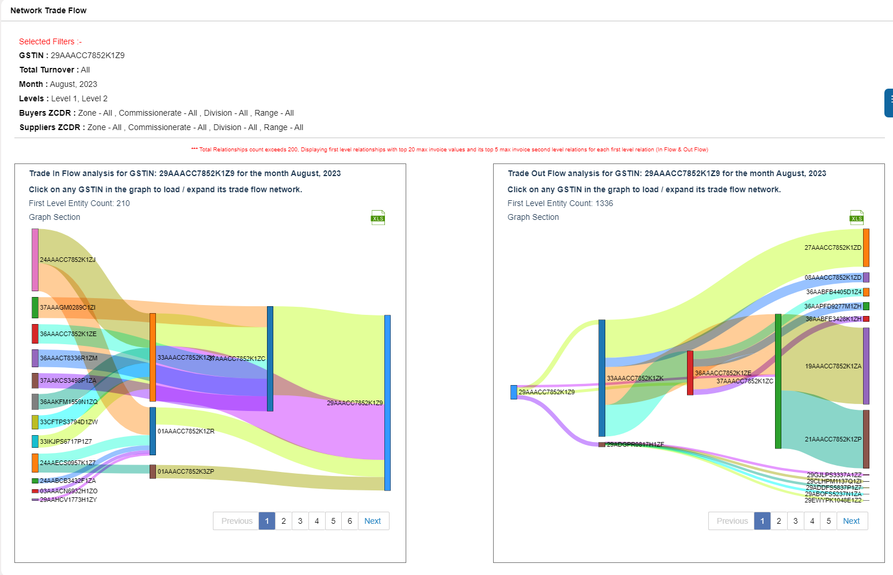
Trade Flow Network
Notes:
For any identified taxpayer, a 5 level network of buyers and suppliers can be generated using this simple and easy to understand functionality. It can be prepared for a month, quarter or a year. Upon selecting any GSTIN in the network, it populates the complete network of selected GSTIN

Slide 23
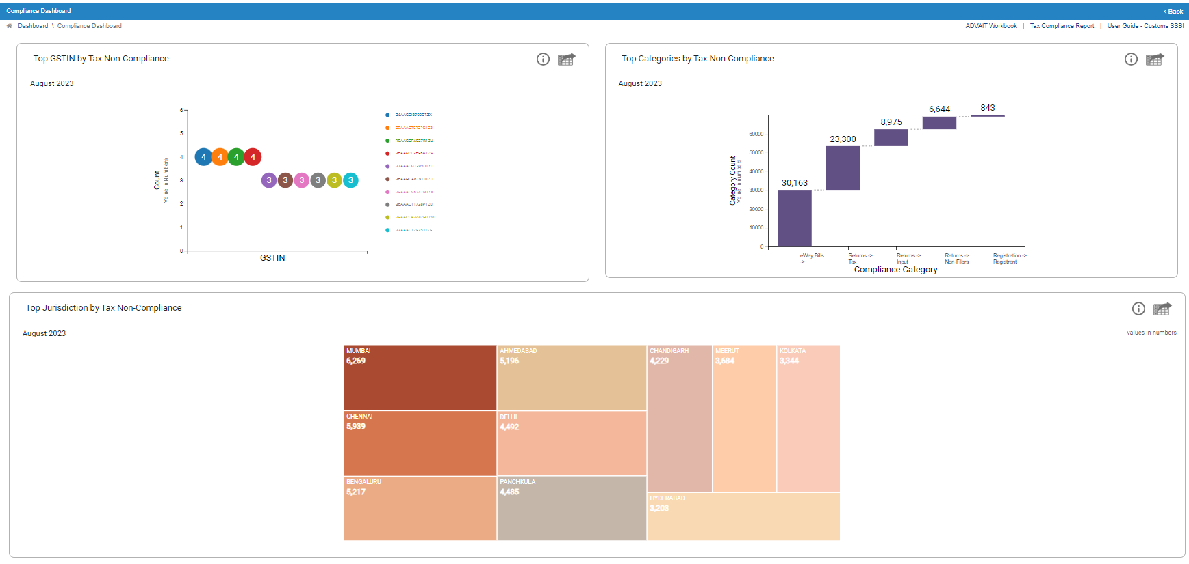
Compliance (alert) dashboard
Notes:
It provides the list of alerts generated for the taxpayers on account of various mismatches. Shows the top taxpayers and top jurisdictions with highest count of alerts and also which the top categories of alerts

Slide 24
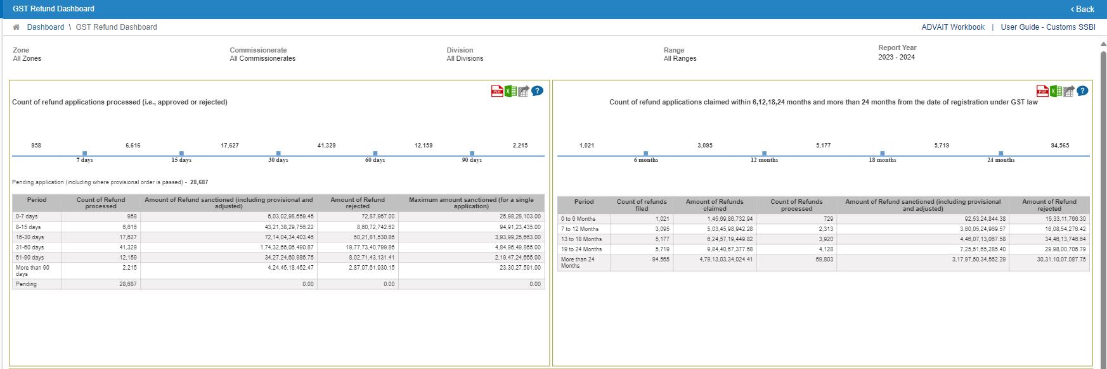
GST Refund Dashboard
Notes:
Helps in keeping a check on refund being claimed or granted suspiciously. Here the timeline shows the counts of refunds granted within 0-7 days or 7-15 days of being applied as well as the amount of refund granted. Say if a big refund of multi million is granted within 7 days, it may raise alert as it practically impossible for the officer to verify the documents in a such a short span. Similarly, we are also showing the timeline of refund applied within 0-6 months of registration, 6-12 months of registration and like wise. All the data can be downloaded refund application wise.

Slide 25
Commodity Level Analytics

Slide 26
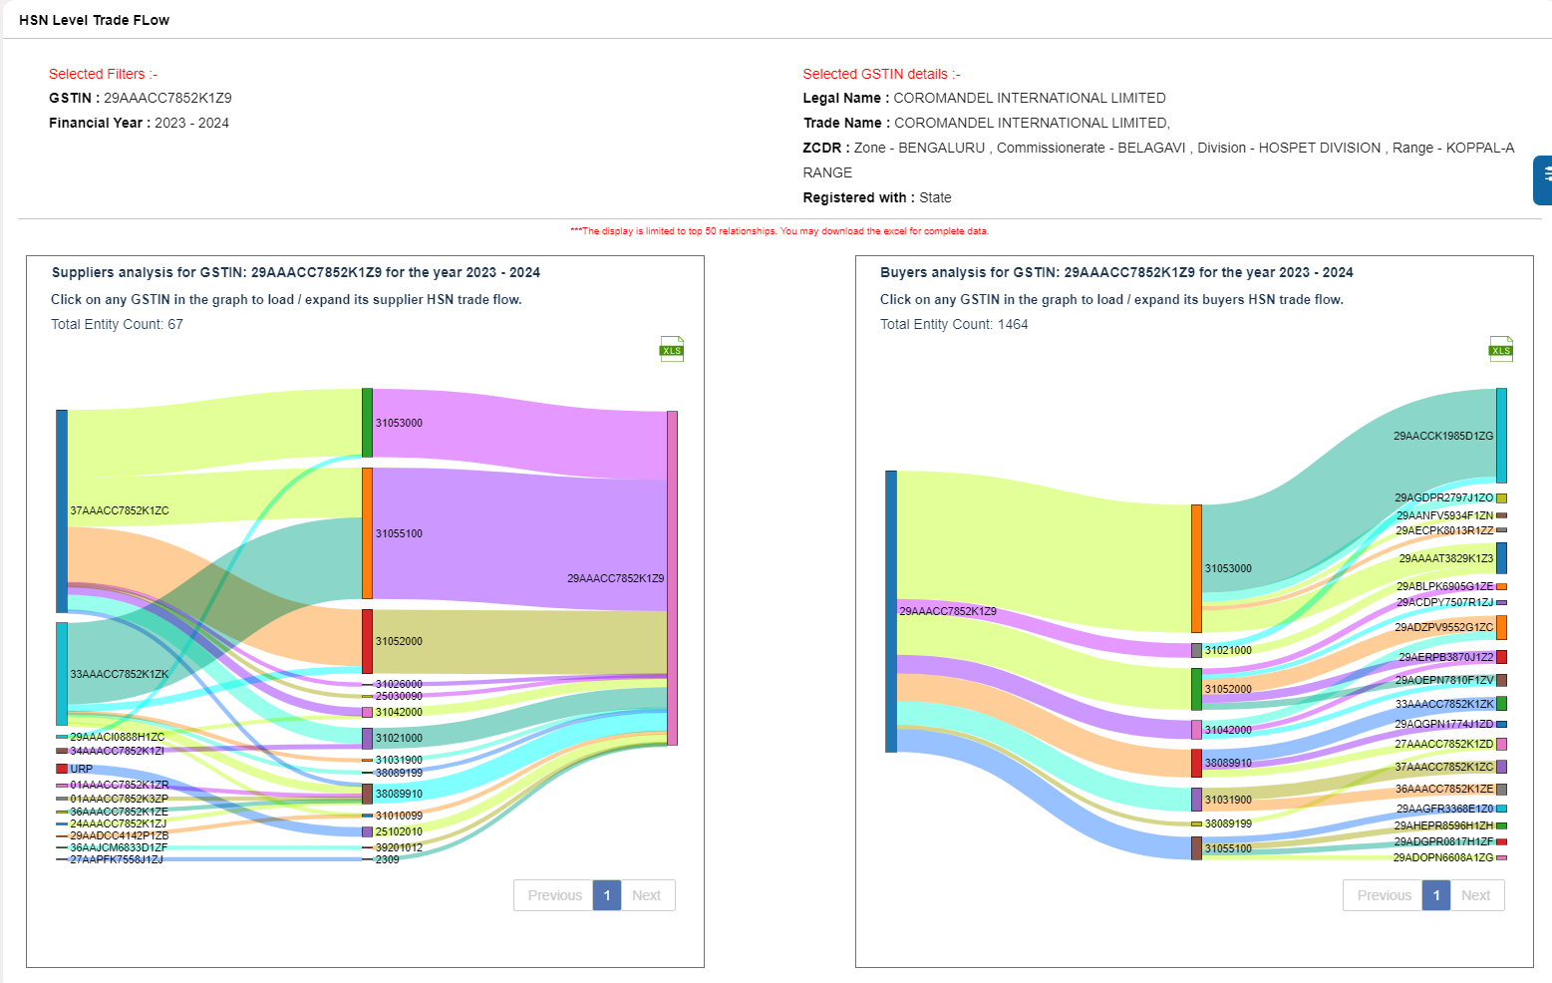
HSN Trade Flow
Notes:
For any selected GSTIN, HSN wise list of buyers and suppliers can be seen with the help of HSN trade flow

Slide 27
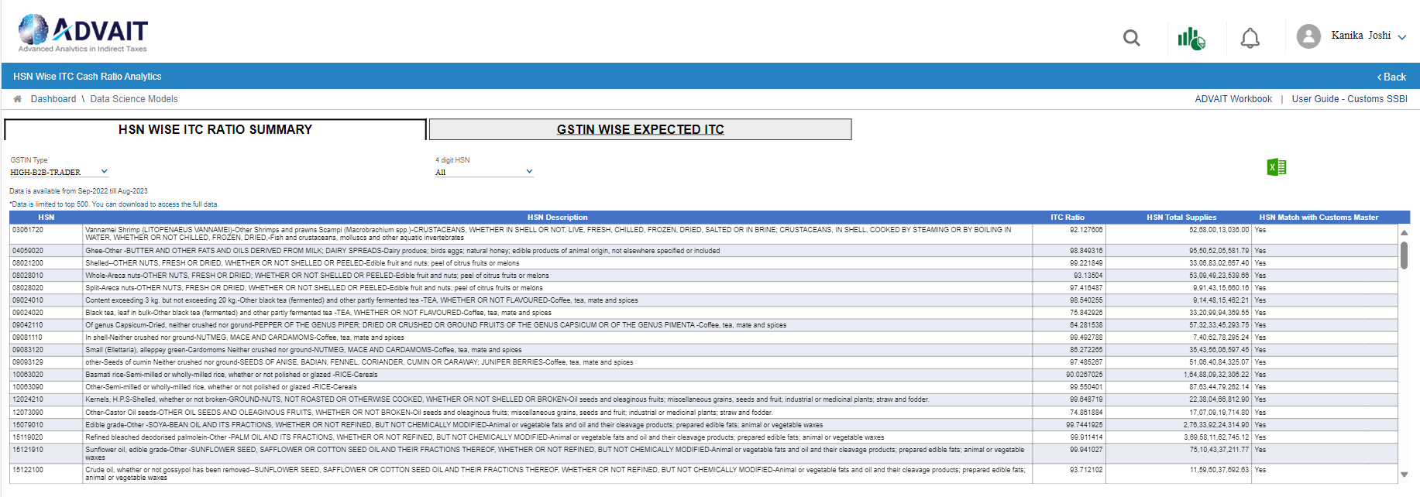
HSN wise cash ITC ratio
Notes:
It displays the industry average of ITC ratio for supplying any Commodity. Also at a taxpayer level, it shows the expected ITC ratio using the weighted average of commodities supplied

Slide 28
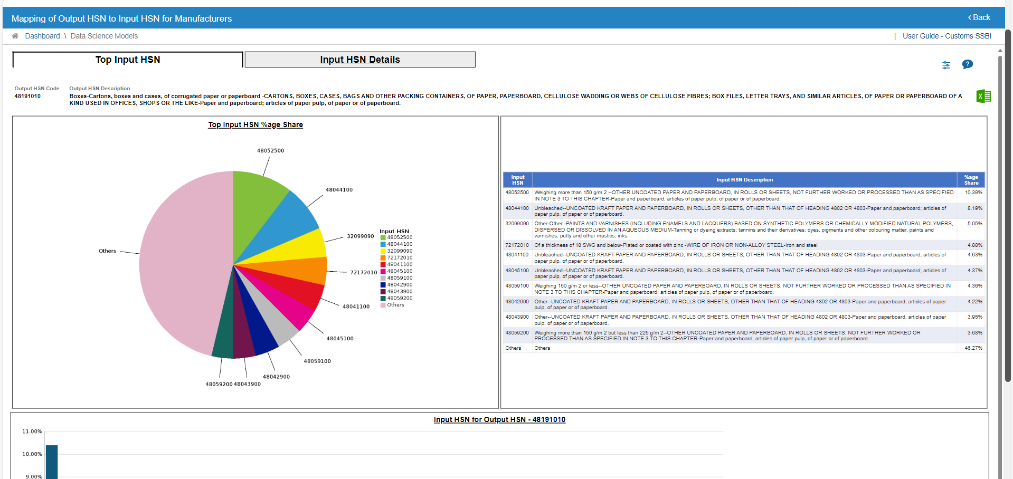
Output HSN to Input HSN mapping
Notes:
Shows the industry vide mapping of input HSNs required for manufacturing of an output HSN and vice versa

Slide 29
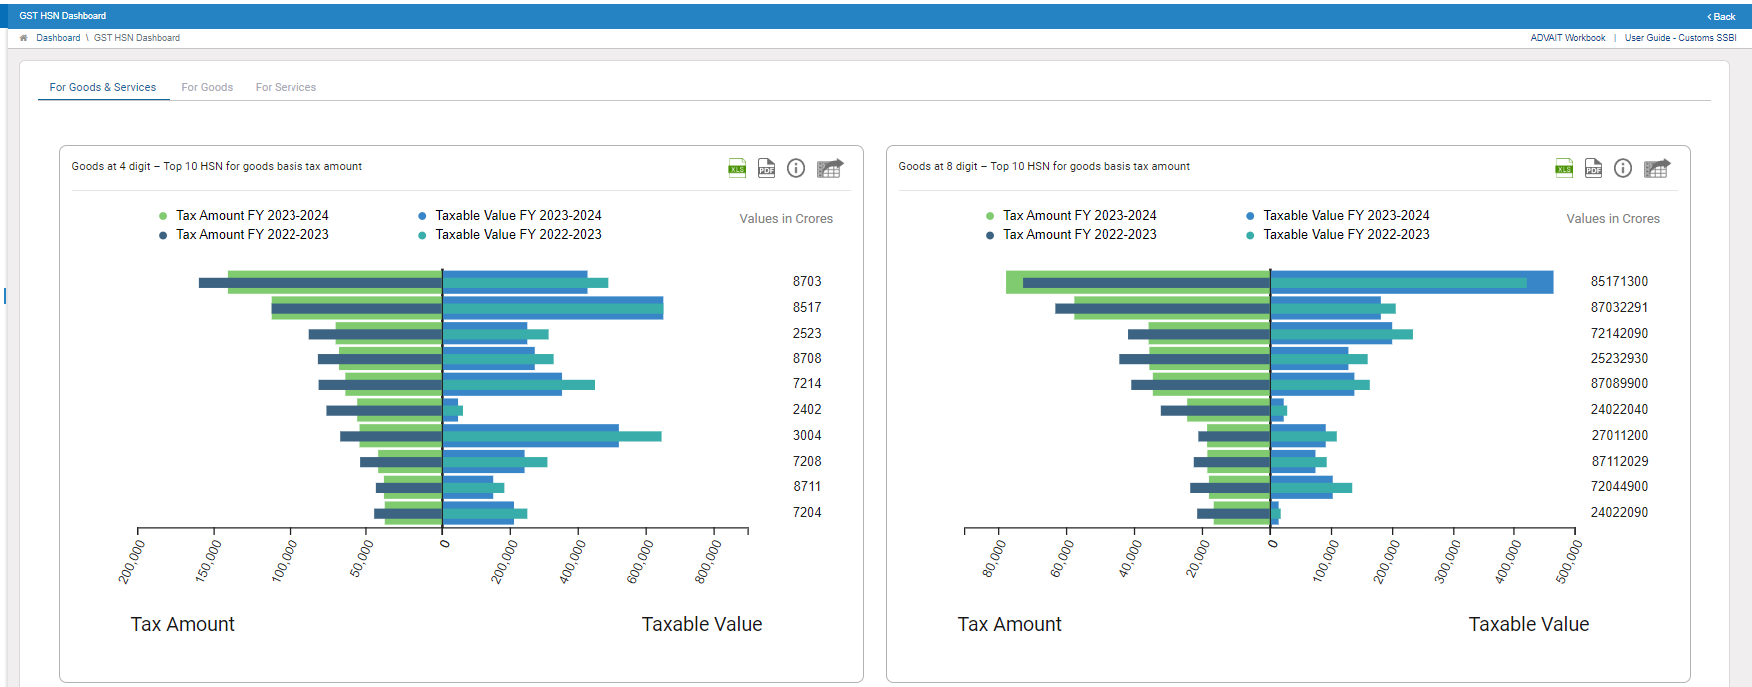
HSN Dashboard
Notes:
Show the list of top goods and services HSNs in the jurisdiction of the officer. Also, for any selected HSN at 2, 4, 6 or 8 digit level, it shows the top taxpayers basis taxable value and tax value

Slide 30
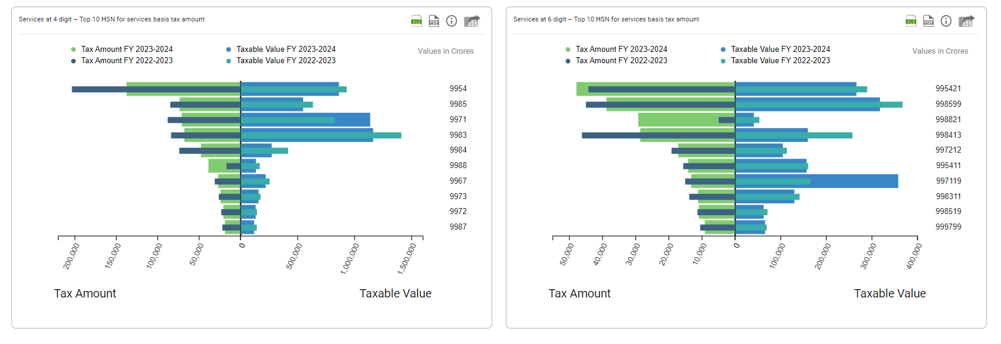
HSN Dashboard

Slide 31
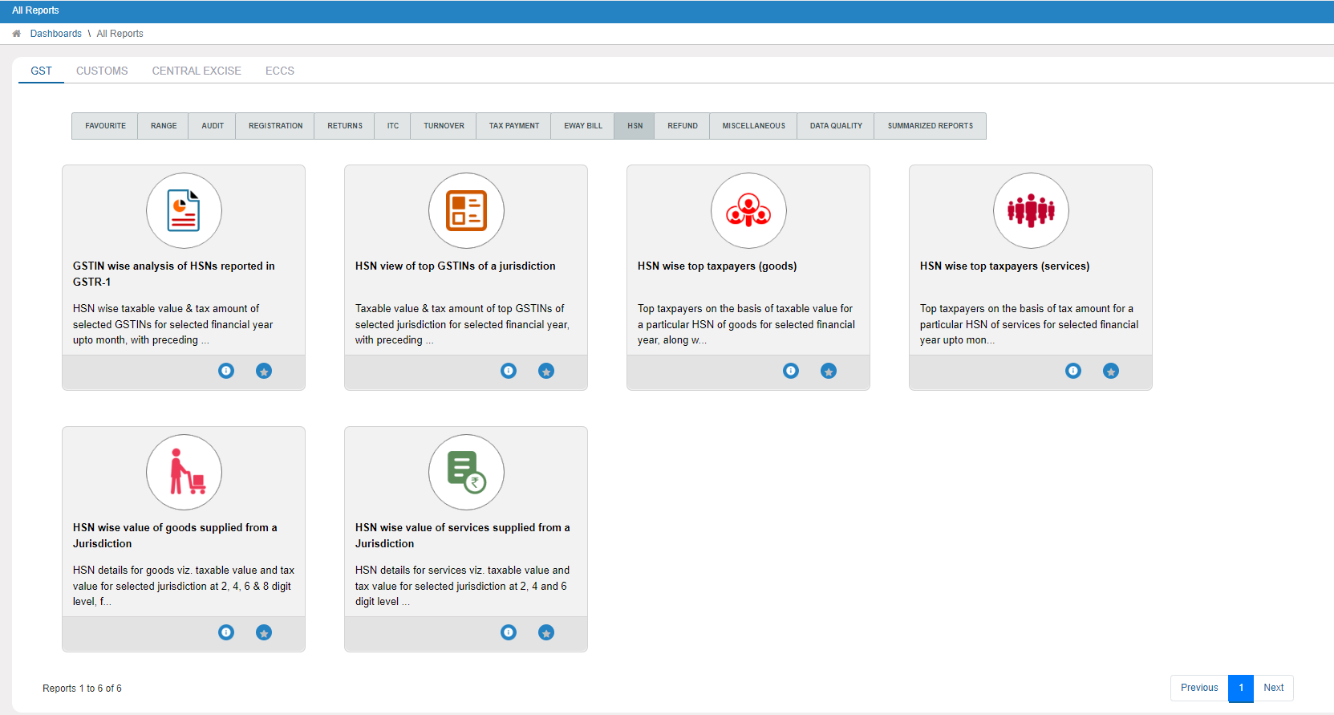
HSN Reports
Notes:
Here it is a complete bouquet of reports on HSN data

Slide 32
For Scrutiny/Audit/Assessments

Slide 33
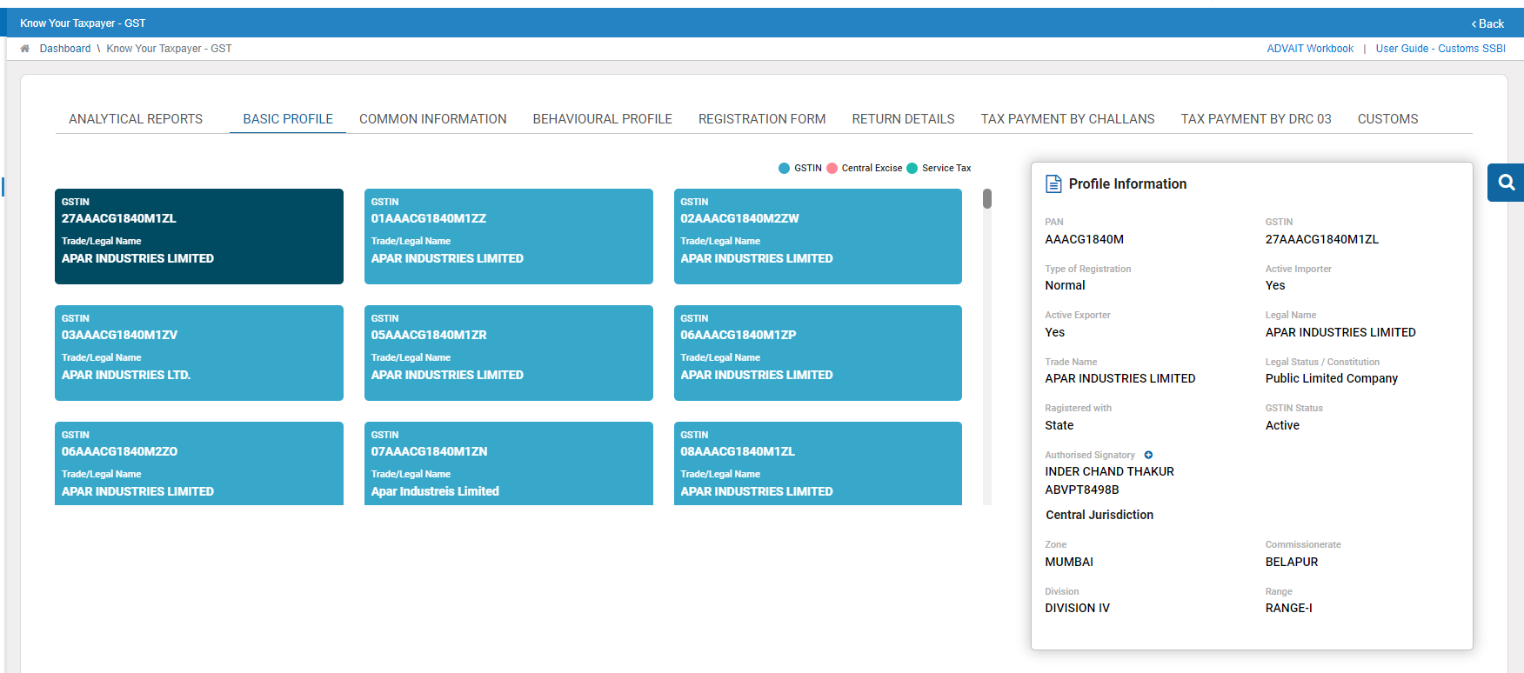
KYT Dashboard and Entity Dashboard
Notes:
Shows the complete profile of a taxpayer across GST and CBDT at a single place, their registration data, returns filed, tax paid etc.

Slide 34
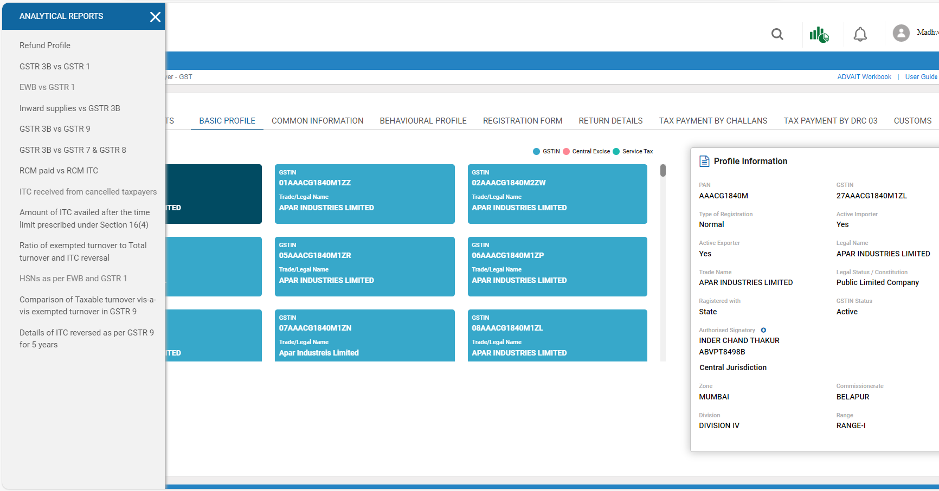
KYT Dashboard and Entity Dashboard
Notes:
At the same place, one can see various analytical reports for the taxpayer including mismatches, refund profile, ITC recoverable ect.

Slide 35
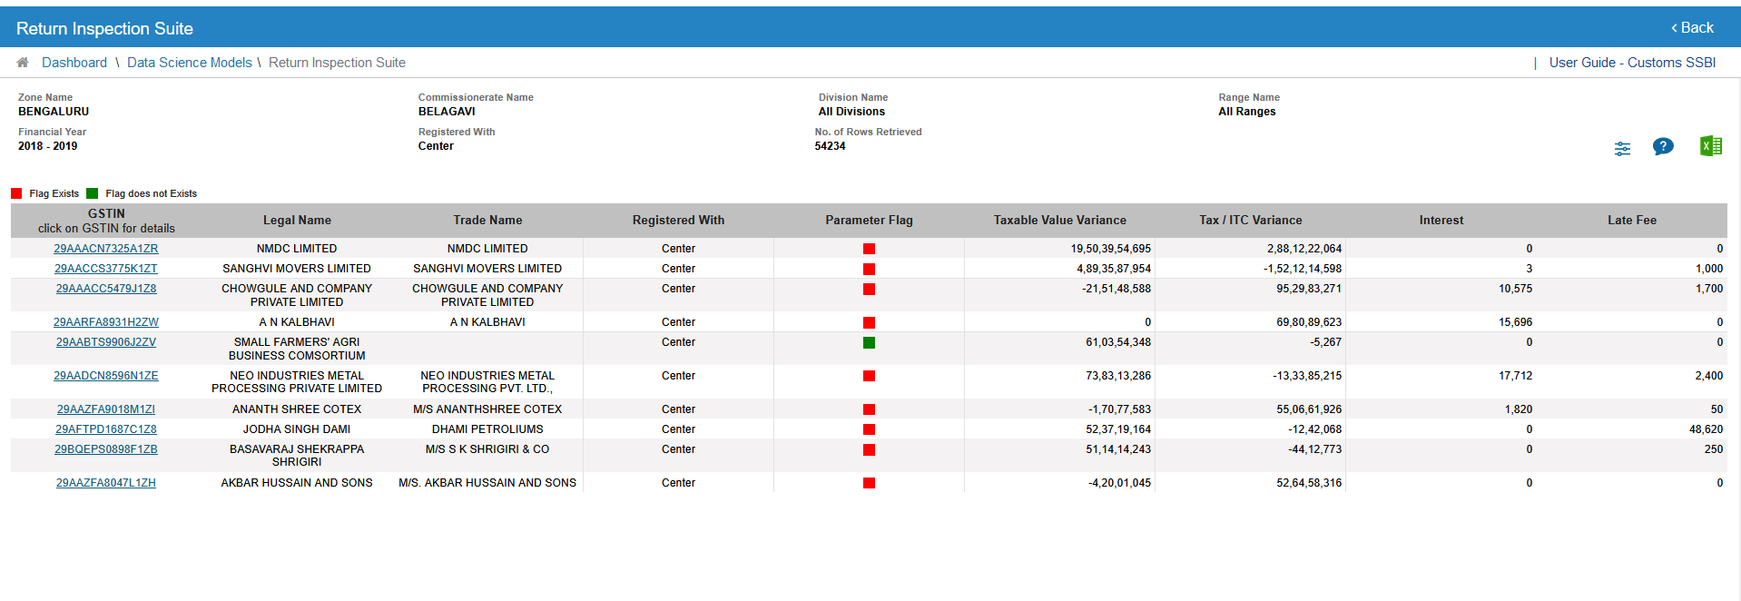
Return Inspection Suite
Notes:
This is a single stop solution for completing the scrutiny / assessment of a taxpayer. It provides the output on all the parameters provided in the scrutiny circular issued by the department

Slide 36
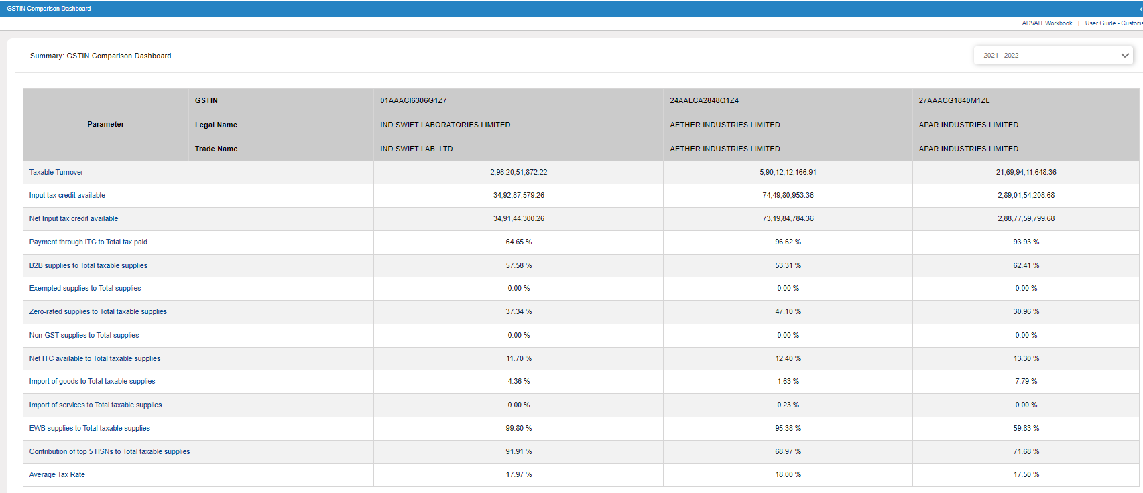
GSTIN Comparison dashboard
Notes:
Officers can select any 5 GSTINs operating in same industry and compare them on 13 analytical parameters like, trend of ITC cash ratio, increase / decrease in turnover, ITC reversal, B2C supplies, import of services etc.

Slide 37
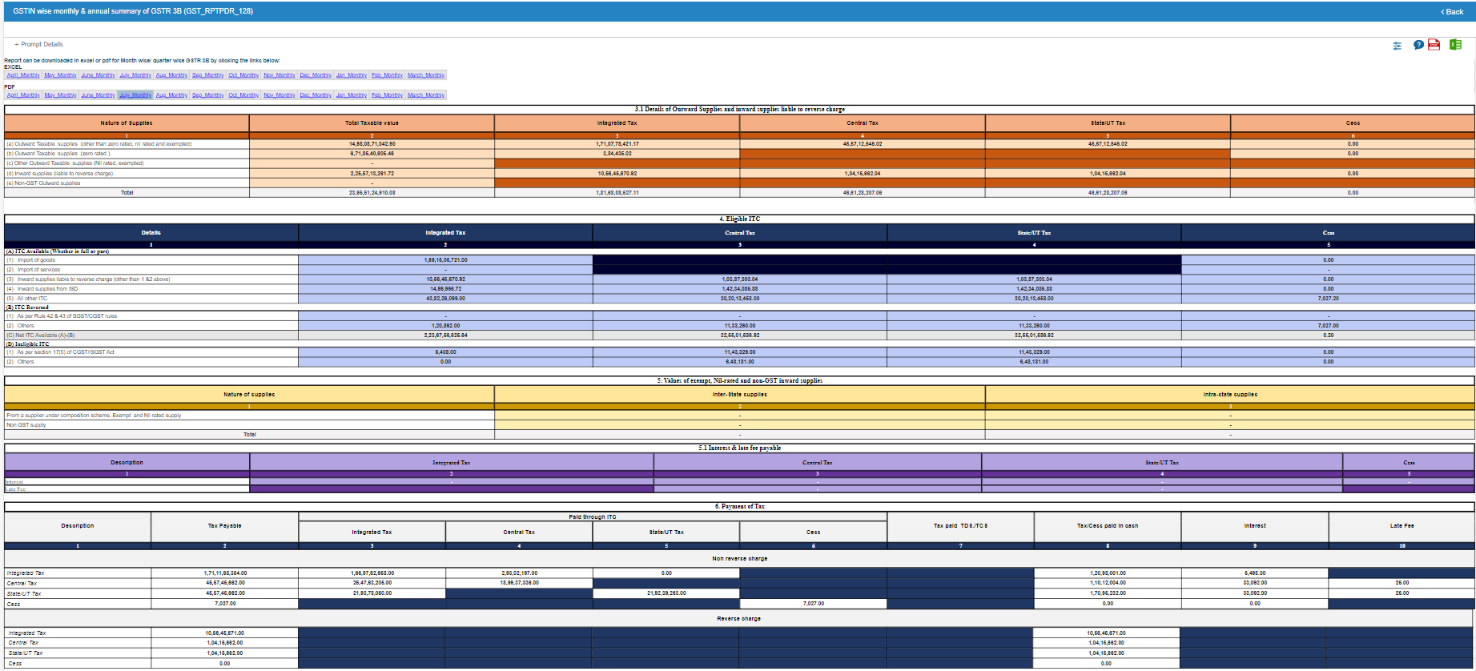
GSTIN & PAN wise monthly & annual summary of GSTR 3B
Notes:
Annually aggregated data from GSTR-3B reducing the efforts of manually collating and aggregating the data

Slide 38
Thank You

