Slide 1
Steps Identified in Detection of Non-genuine Taxpayers (NGTP)/ Fraudulent Taxpayers
Presentation by Dheeraj Rastogi, EVP (Services) GSTN
4th March 2024

Slide 2
Identification of potential Fake taxpayers
Supplier
Recipient
01
01
Suspicious Behaviour of Taxpayers
(Fake invoice Generators, Suppression of Sales)
Suspicious Behaviour of Taxpayers
(Fake invoice Generators, Suppression of Sales)
02
02
Spike in turnover and ITC (passing or utilization)
Beneficiaries of suo-motu cancelled GSTINs
03
03
Mismatch in outward supplies
Ratio Analysis
IP Address Based Analytics where supplier and recipients from different states doing compliance from same IP Address
04
04
Mismatch in inward supplies
05
05
Service provider utilizing ITC of goods, etc
Suspicious Vehicle Movement

Slide 3
Other Important BIFA Analytical Tools
Suspicious Transactions
High ITC utilization in B2C
Missing Taxpayers
Network Score
Beneficiaries of suo-motu cancelled taxpayers
Form 26AS vs GSTR-1
Spike in ITC behaviour
Comparison of GSTR7/GSTR8 with GSTR3B

Slide 4
Investigation Support Tools
Investigation Support System - Data Extraction Dashboard
GST Profile (360º View of a GSTIN)
Related Entities Based on Common Linkages/Parameters
Network Score
Network Analysis

Slide 5
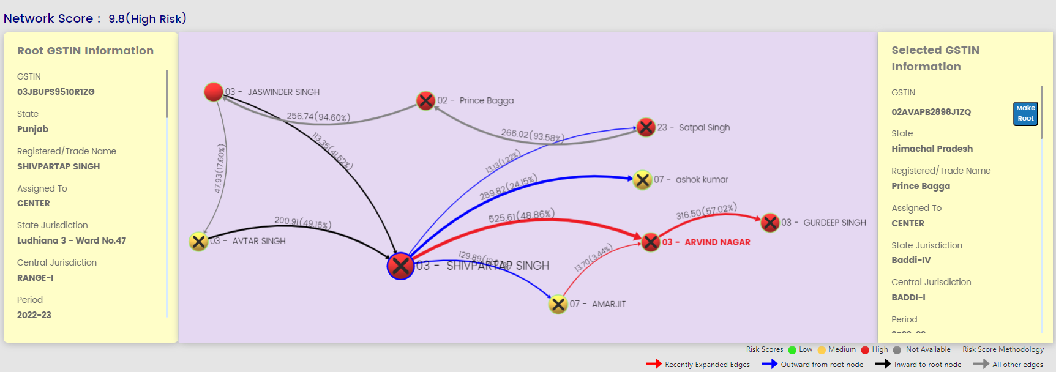
BIFA Analysis - Network Score

Slide 6
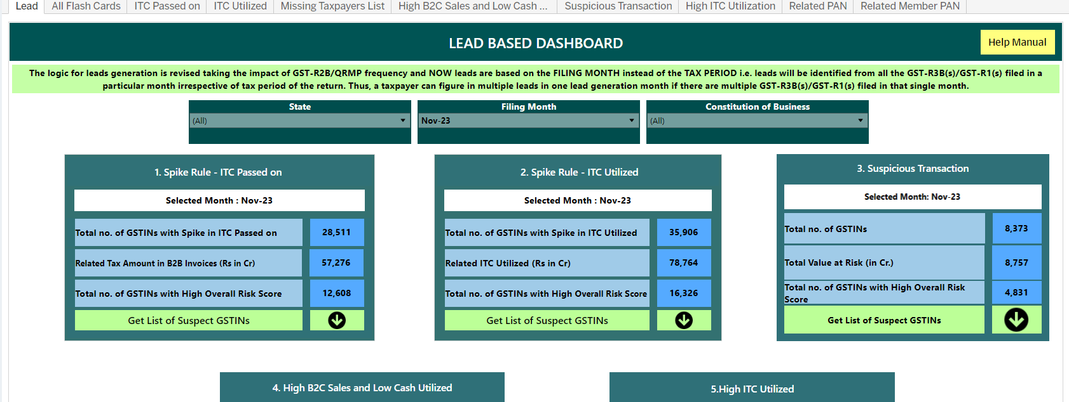
BIFA Analysis – Lead Dashboard

Slide 7
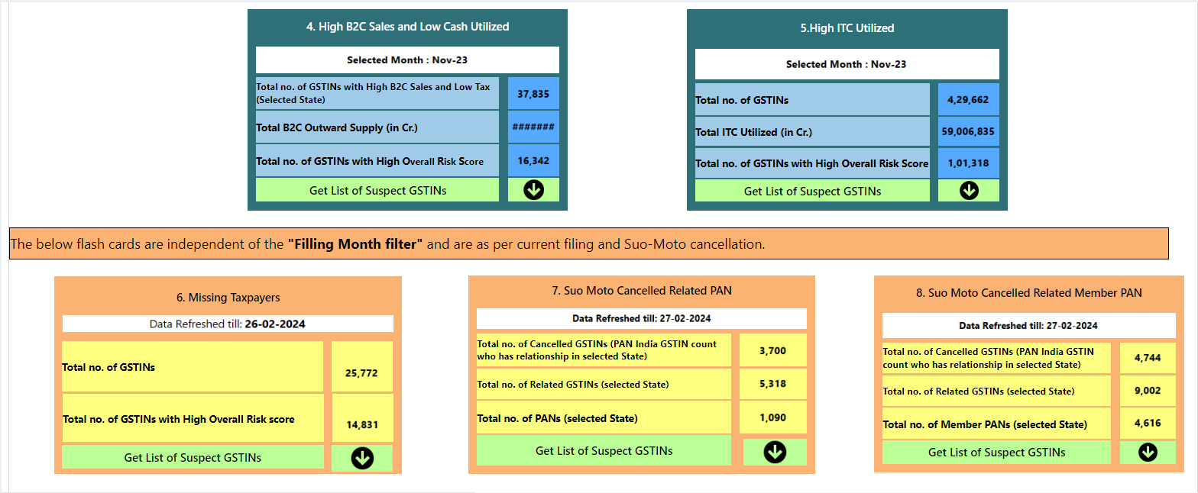
BIFA Analysis – Lead Dashboard 2

Slide 8
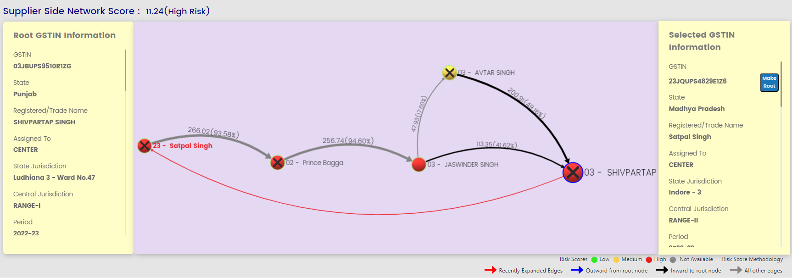
BIFA Analysis - ITC Reliability Score

Slide 9
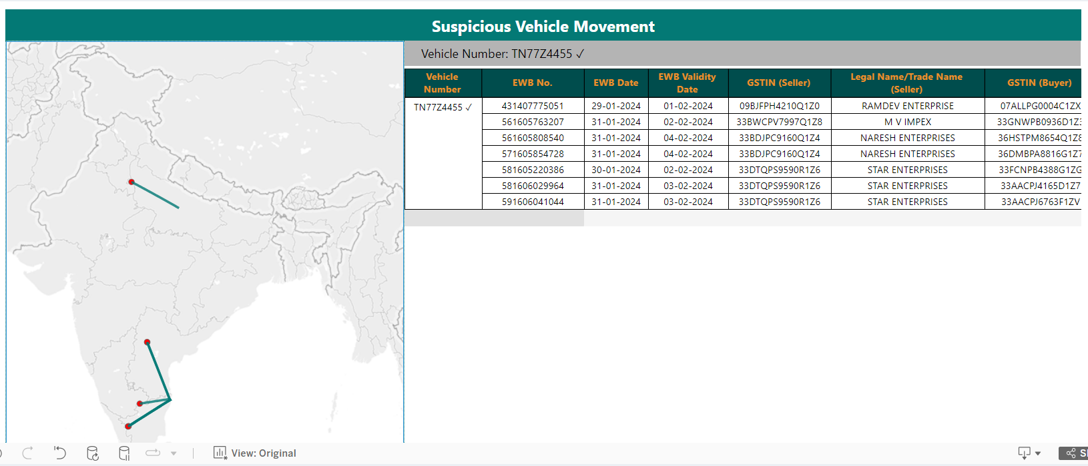
BIFA Analysis – Suspicious Vehicle Movement

Slide 10
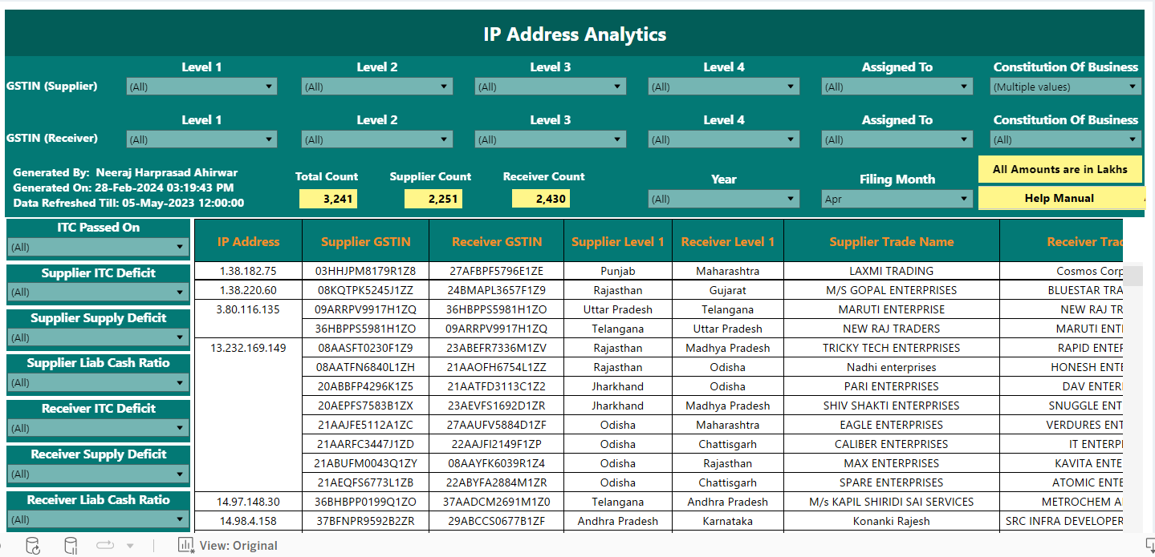
IP Address Analytics

Slide 11
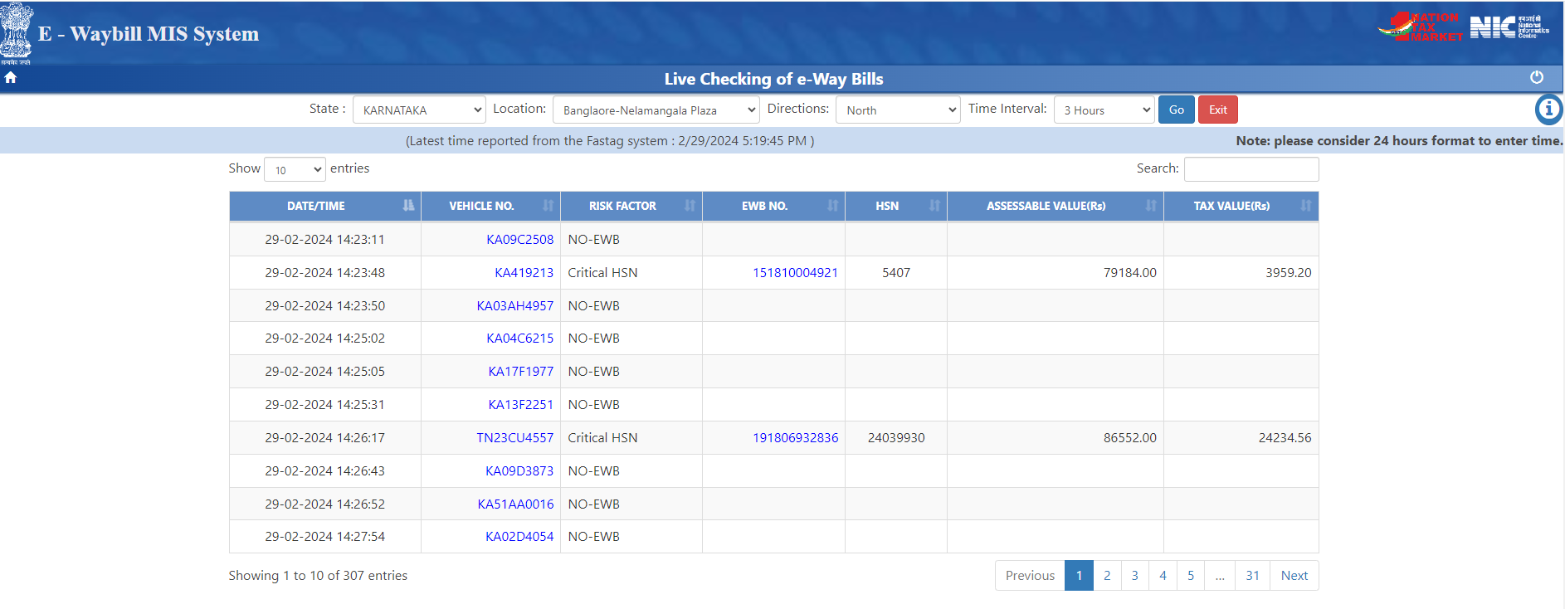
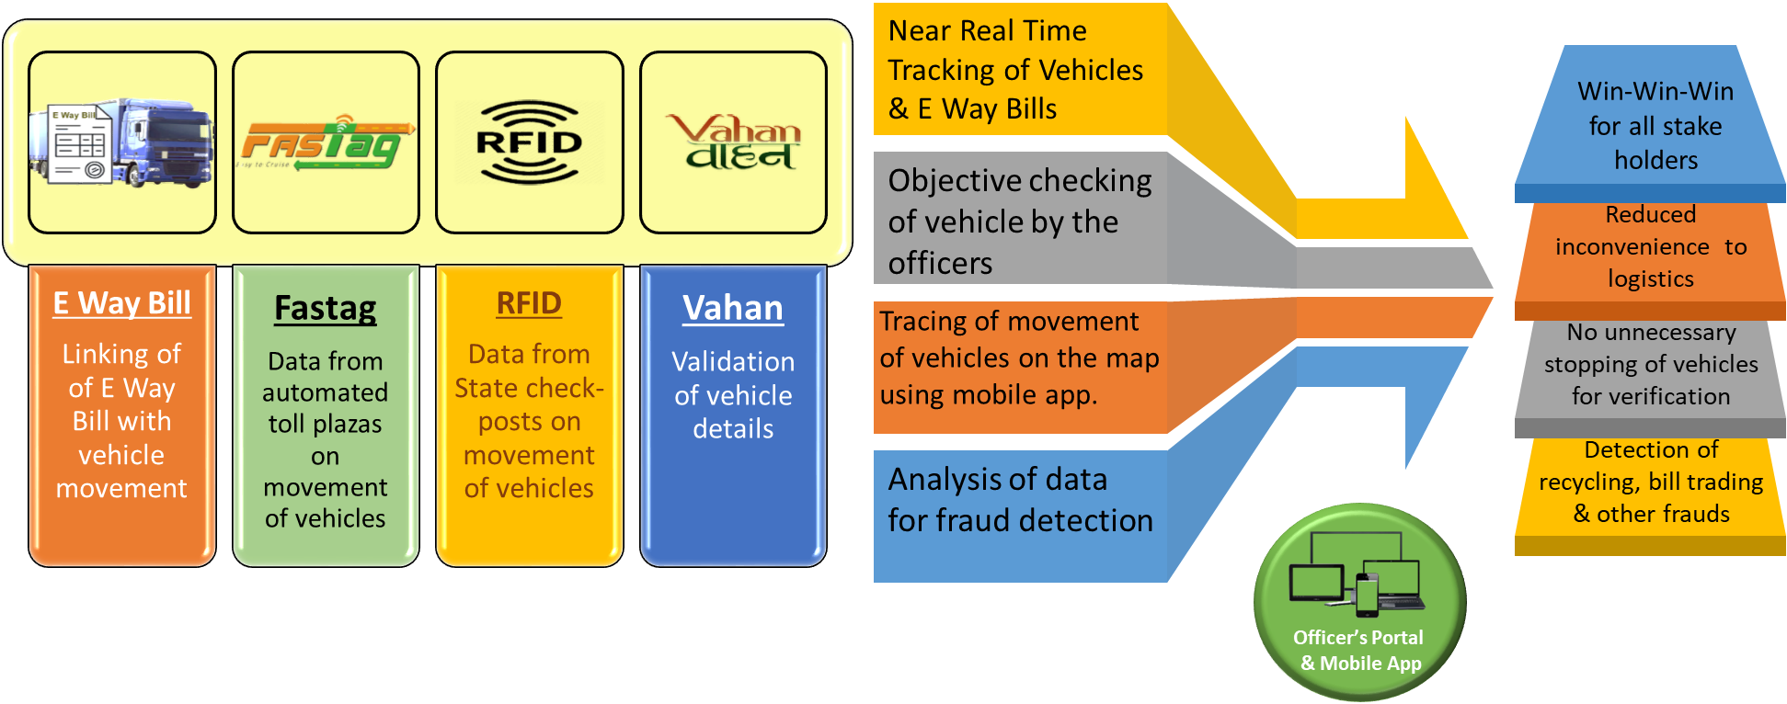
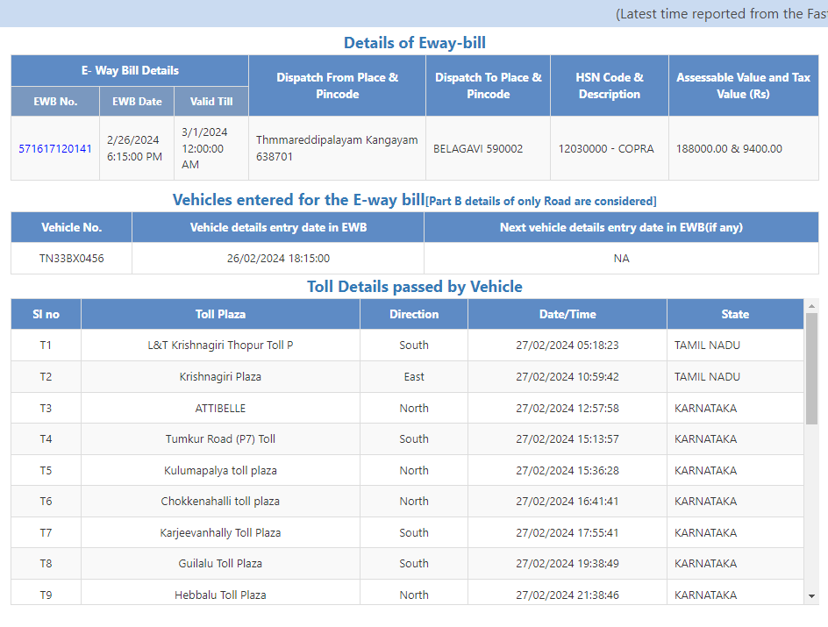
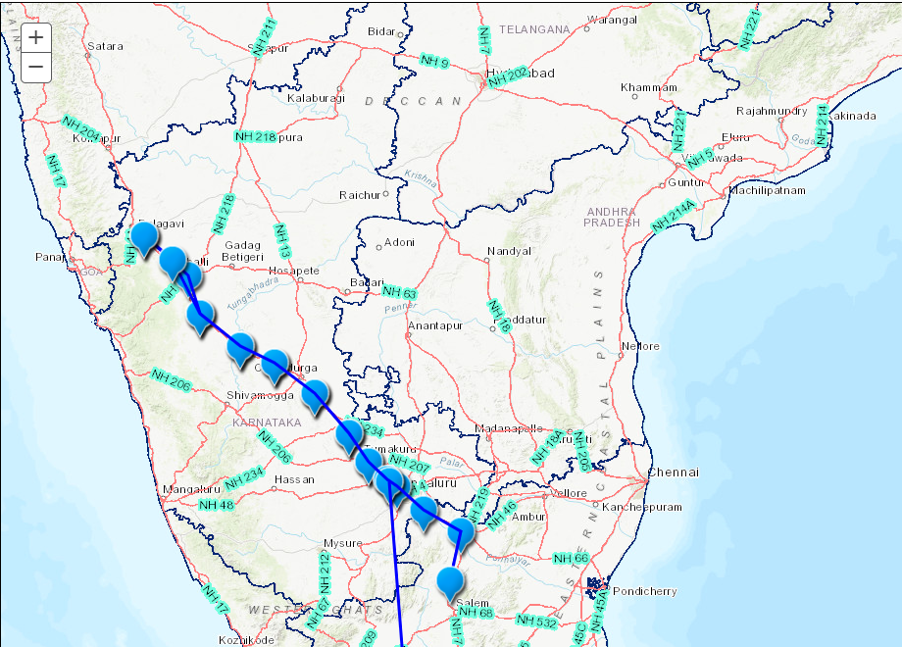
E-WAY BILL ANALYTICS
Analytics on E Waybill Integration with FASTAG and VAHAN
Live tracking of vehicles & e-Waybills using Mobile apps
Live tracking of vehicles carrying tax evasion prone commodities
Detection of re-cycling of e-Waybills
Detection of bill trading by tracking vehicles of EWB
Latest tolls passed by details of any vehicle.

Slide 12
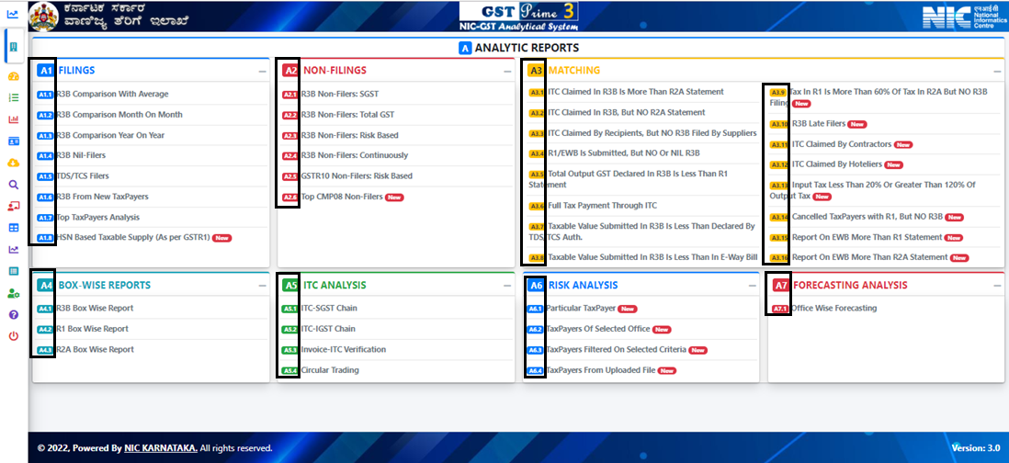
GST Prime: Analytical Report
Top and Risk Defaulters
Mismatching Reports
Self Query based Reports
Risk based Reports
ITC Chain and Verification

Slide 13
THANK YOU!!

