Slide 1


Slide 2
Important Insights about the Insurance Sector
The insurance industry of India has 57 insurance companies - 24 are in the life insurance business, while 34 are non-life insurers.
Life Insurance Corporation (LIC) is the sole public sector company among the life insurers with 66.2% of the ‘life insurance’ market. Whereas there are six public sector insurers in the non-life insurance segment.
The market share of private sector companies in the general and health insurance market increased
from 48.03% in FY20 to 49.31% in FY21.
Insurance reach is still low in India. Overall insurance penetration (premiums as % of GDP) was 4.2% in FY21, providing a huge underserved market.

Slide 3
Basics Concepts - Insurance Sector
What is Insurance?
Insurance is a legal contract between two parties which consists of the insurance company (insurer) and the individual (insured), in which the insurance company agrees to financially protect the insured individual for financial losses caused by a type of event which qualifies as the one to be insured in exchange for the premiums paid by an individual.
Types of insurance products
Insurance products can be generally classified as either Life insurance products or General Insurance products.
Life insurance protects you from the likelihood of unforeseen financial loss from dying. Term plans, endowment plans, whole life insurance plans, money back plans, and unit-linked investment plans are just a few examples of life insurance policies which can be an excellent tool for long-term savings.
General insurance products, on the flip side, cover financial losses caused by a variety of risks other than those related to mortality. Health insurance, motor insurance, marine insurance, liability insurance, travel insurance, and commercial insurance are all examples of general insurance products that cover a wide range of risks.

Slide 4
Impact on Outward Supplies

Slide 5
LEVY u/s 9(1) – Outward Supplies
Outward Revenue | Chargeability | Remarks
1. Insurance Premium |  | (Refer Exemption slide)
Life Insurance | GST @ 18% | Refer Next Slide for detailed Rates
Non-Life Insurance | GST @ 18%
2. Investment Income
Interest/Dividend | No GST | Interest is Exempt. Divided is appropriation of Profit
Rent | Depends | Rent from Residential Accommodation for residence is exempt
3. Sale of Investments/Assets
Shares/Debenture/Bonds | No GST | Neither Goods Nor Services Value to be included in Exempt Supplies for the purpose of sec 17(2) Reversal
Land/Building | No GST | Sch III – Not regarded as supply
Other Assets | GST | Valuation & chargeability depends on whether ITC is available on acquisition
4. Foreign Exchange Gain/Loss | No GST | Transaction in Money
5. Other Charges | Depends | Refer next slide
 |  |  | Type your

Slide 6
LEVY u/s 9(1) – Outward Supplies
GST On Insurance Premium
S. No. | Type of Plans | GST Charged on | GST Rate
1 | Term and Health Plans | Premium | 18%
2 | ULIP Plans and ULIP Type Plans | Insurance Portion | 18%
3 | First Year Premium of Annuity Plans except plans mentioned in S.No. 1 & 2. | Premium | 4.50% *
4 | Renewal Premium of Life, Pension and AnnuityPlans except plans mentioned in S.No. 1 & 2 | Premium | 2.25% **
5 | Single Premium of Annuity Plans | Premium | 1.80%***
Rule 32(4), Chapter IV of CGST Rules 2017 determines 25% of premium charged in first year to be the value of supply. Accordingly 18% GST is charged on 25% value of premium.
** Rule 32(4), Chapter IV of CGST Rules 2017 determines 12.5% of premium charged in subsequent years to be the value of supply. Accordingly 18% GST is charged on 12.5% value of premium.
*** Rule 32(4), Chapter IV of CGST Rules 2017 determines 10% of single premium Annuity policies premium to be the
value of supply. Accordingly 18% GST is charged on 10% value of premium in single premium Annuity policies .

Slide 7
LEVY u/s 9(1) – Outward Supplies
GST Impact on Other Charges collected
GST on Interest Charged for Delayed Premium i.e. late fees – GST is applicable @ 18% on interest charges on delayed receipt of premium except the interest
charges on delayed receipt of premium on exempt polices.
Cheque Dishonor Charges – GST is applicable on CDA Charges including postage@ 18% rate
GST is applicable on charges paid by policyholders as alteration fee / quotation fee/ duplicate policy preparation
charges
GST is applicable on charges recovered for granting a written acknowledgement for receipt of notice of assignment/ registering cancellation or change of nomination.

Slide 8
LEVY u/s 9(1) – Outward Supplies – Litigative Issues
GST Incidence on 1st Premium received
Modality while Issuing a New Policy: -
The proposal form is duly signed by the prospective policy holder. Along with this proposal form, the proposed policy holder is also required to give an amount called “proposal deposit”. Once the proposal form along with the proposal deposit has been received, the insurer carries out the underwriting so as to determine the risk undertaken by company on issuance of the policy.
Based on the underwriting advice, either the policy is issued or further financial/medical examinations etc. are carried out through third party examiners. Until the evaluation process is not completed the company is not aware whether it will provide the insurance service. In some cases the proposal is rejected and the full amount of deposit is refunded to the prospective policy holder.
Litigative Issue: - Whether the Time of Supply would be the date on which the insurance company receives the amount of proposal deposit or the date on which the policy is issued and amount of proposal deposit is appropriated as premium ?
Decision : The company does not provide insurance service to each of the prospective policy holder.
It evaluates the proposal and based on the evaluation agrees/disagree to provide the service. Therefore the agreement of provide the service does not happen at the proposal stage.
After Underwriting the policy GST levi incidence.
Within 45 days of supply of services Insurer has to issue GST Invoice- Rule-47

Slide 9
LEVY u/s 9(1) – Outward Supplies – Litigative Issues
GST Incidence on surrender/ foreclosure charges covered from policy holder for surrendering of policy
Modality of recovering these charges: -
The policy holder is required to pay premium on periodic basis for a specified period under insurance policy. The non-
payment of premium leads to lapse of policy. Under this state, the risk cover is forfeited.
Litigative Issue: - The nature of foreclosure and surrender charge is same. The charge is levied as a penalty for the act of the policy holder of non-payment of premium. The issue is that whether GST can be levied on surrender charge ?
View Taken : It will be evident that surrender charge is in the nature of penalty levied on the policy holder for violation of contract in the form of non-payment of premium. The intention of the insurance company is that every policy holder should complete the term of the policy. Hence these charges are levied as a penalty to discourage the policy holder from surrendering the policy.

Slide 10
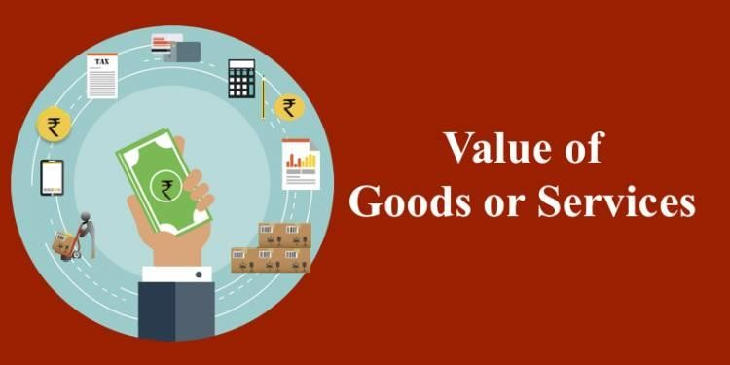
Value of Supply of Services – Sec 15 of CGST Act

Slide 11
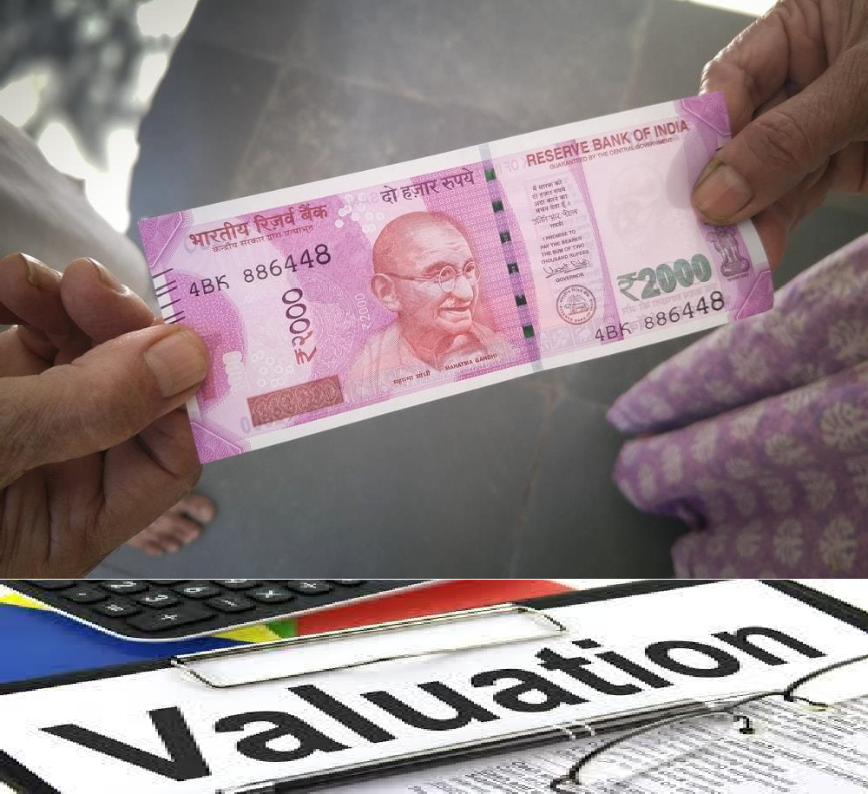


Value of Supply
Sec 15(1) - The value of a supply of goods or services or both shall be the transaction value, which is the price actually paid or payable for the said supply of goods or services or both where the supplier and the recipient of the supply are not related and the price is the sole consideration for the supply.
100%
Monetary
Not Related

Slide 12
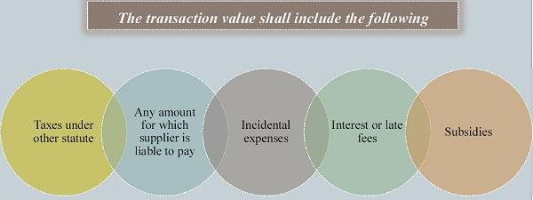
Value of Supply of Services – Sec 15 of CGST Act

Slide 13
Value of Supply of Services – Sec 15 of CGST Act
Rule | Description
Rule 32 | Determination of Value in respect of Certain Supplies
Rule 32(4) | Life Insurance Business

Slide 14
Rule 32(4) – Value in case of Life Insurance Business
Primarily, there are three major kinds of life insurance products – Term insurance plans, Ulips and Endowments (including money back). The premium paid represents two portions – risk coverage and savings. GST is only on the risk portion of the premium and not on savings portion.
S.N. | Circumstances | Value as per the rules
1 | Policies where amount of investment/ saving is intimated to policy holder at the time of supply of service | Gross premium charged (-) amount allocated for investment/ saving as intimated
2 | single premium annuity policies other than (a) | 10% of single premium charged
3 | in all other cases | 25% of the premium in first year and 12.5% of the premium in subsequent years:

Slide 15
Impact on Inward Supplies
Type your text

Slide 16
LEVY under Sec 9(3)(4) – Reverse Charge
Reverse Charge in GST
Section 9(3) of CGST Act
Section 9(4) of CGST Act
Supplier can be Registered / Unregistered
Supplier can be only Unregistered

Slide 17
Reverse Charge – 9(3) of CGST Act- Agent Commission
S.N | Category of Supply of Services | Notification Number
10 | ------ | Notification No.13/2017- Central Tax (Rate) Dated: June 28, 2017 w.e.f. 1st July 2017
11 | Services supplied by an insurance agent to any person carrying on insurance business. Coclusion- Agent Services payment by Insurance Company –GST on RCM must be levied
12 | ----
13 | -----

Slide 18

Time of Supply
Time of Supply of Goods / Services
Goods – Sec 12
Services – Sec 13
Change in Rate – Sec 14

Slide 19
Time of Supply of Service – Sec 13 of CGST Act

Slide 20
Time of Supply of Services – Sec 13 of CGST Act
The time of supply of service shall be the earlier of the following dates, namely :-
Time of Supply of Service u/s 13
If the Invoice is issued u/s 31(2)
Other Cases
Within the time(u/s.13-2-a)
Earliest of
Date of Invoice Or
Receipt of payment
Not Within the time(u/s.13-2-b)
Earliest of
Provision of service
Or
Receipt of payment
(u/s.13-2-c)
Date on which the recipient shows the receipt of services in his books of account,

Slide 21

Place of Supply of Service – Sec 12/13 of IGST Act
Abbreviation in this Chapter
LOS – Location of Supplier
LOR – Location of Recipient
POS –Place of Supply

Slide 22
Place of Supply of Service – Section 12 vs Section 13 of IGST Act
S.N. | POS of services
1 | Section 12: services where the location of supplier of service and the location of the recipient of services is in India
2 | Section 13: services where the location of supplier of service or location of the recipient of services is outside India

Slide 23
General Provision - Sec 12(2) of IGST Act
Supply made to
Registered Person
Other person
Address on record exists
Other cases
Location of
recipient
Location of
recipient
Location of
supplier

Slide 24
The place of supply of insurance services – Sec 12(13) of IGST Act
to a registered person,
  Place of Supply be the location of such person;
to a person other than a registered person,
  Place of Supply be the location of the recipient of services on the records of the supplier of services.

Slide 25
Place of Supply of Service –Section 13 of IGST Act
Services | Place of Supply
The POS of services except the services specified in sub- sections (3) to (13) | Location of Recipient
Provided that where the Location of recipient is not available then place of Supply will be Location of Supplier
POS where Location of supplier or location of recipient (Any One) is outside India.

Slide 26
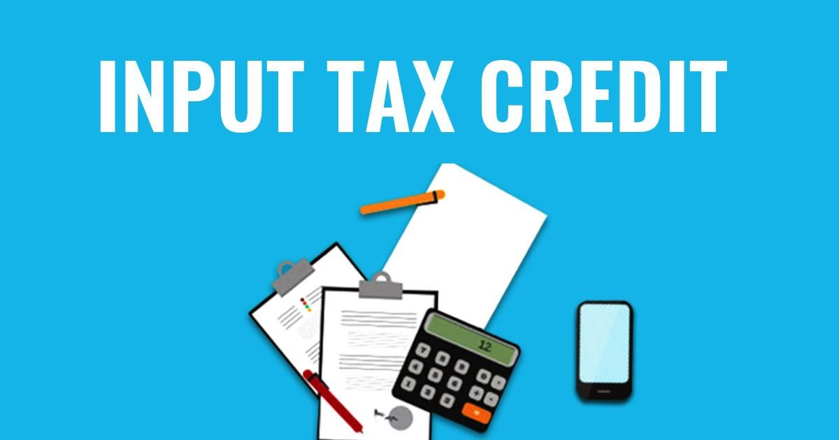
Input Tax Credit
Sec 16 to 18 of CGST Act

Slide 27
Block Input Tax Credit
Section 17(5)of CGST Act –Notwithstanding anything contained in sub-section (1) of section 16 and subsection (1) of section 18, input tax credit shall not be available in respect of the following, namely:—
17(5-b-iii) rent-a-cab, life insurance and health insurance except where––
the Government notifies the services which are obligatory for an employer to provide to its employees under any law for the time being in force; or
(B) such inward supply of goods or services or both of a particular category is used by a registered person for making an outward taxable supply of the same category of goods or services or both or as part of a taxable composite or mixed supply; and

Slide 28

Invoice & E Invoicing in GST for Insurance Sector
Invoice Accounts & Records

Slide 29
Invoice, Accounts and Record in GST for Insurance Service
Section | Section | Rule | Rule
Section 31 | Tax invoice. | Rule 46 | Tax invoice
Section 31A | Facility of digital payment to recipient | Rule 46A | Invoice-cum-bill of supply
Section 32 | Prohibition of unauthorized collection of tax. | Rule 47 | Time limit for issuing tax invoice
 |  | Rule 48 | Manner of issuing invoice
Section 33 | Amount of tax to be indicated in tax invoice and other documents. | Rule 49 | Bill of supply
 |  | Rule 50 | Receipt Voucher
Section 34 | Credit and debit notes. | Rule 51 | Refund Voucher
 |  | Rule 52 | Payment Voucher
 |  | Rule 53 | Revised tax invoice and credit or debit notes.-
 |  | Rule 54 | Tax invoice in special cases (ISD/Banking Co etc)
 |  | Rule 55 | Transportation of goods without issue of invoice
 |  | Rule 55A | Tax Invoice or bill of supply to accompany transport of goods.-

Slide 30
Rule 47. Time limit for issuing tax invoice for Supply of Service
The invoice referred to in rule 46, in the case of the taxable supply of services, shall be issued within a period of thirty days from the date of the supply of service:
Provided that where the supplier of services is an or a banking company or a financial
insurer
institution, including a non-banking financial company, the period within which the invoice or any document in lieu thereof is to be issued shall be forty five days from the date of the supply of service:
Provided further that an or a banking company or a financial institution, including a non-banking financial company, or a telecom operator, or any other class of supplier of services as may be notified by the Government on the recommendations of the Council, making taxable supplies of services between distinct persons as specified in section 25, may issue the invoice before or at the time
such supplier records the same in his books of account or
before the expiry of the quarter during which the supply was made.
insurer

Slide 31
Rule 54. Tax invoice in special cases.-
  54(2)Where the supplier of taxable service is an insurer or a banking company or a financial institution including a non-banking financial company, the said supplier may issue consolidated tax invoice or any other document in lieu thereof, by whatever name called for the supply of services made during a month at the end of the month], whether issued or made available, physically or electronically whether or not serially numbered, and whether or not containing the address of the recipient of taxable service but containing other information as mentioned under rule 46.
Provided that the signature or digital signature of the supplier or his authorised representative shall not be required in the case of issuance of a consolidated tax invoice or any other document in lieu thereof in accordance with the provisions of the Information Technology Act, 2000 (21 of 2000).

Slide 32
Exemption and Requirement of E Invoice [NN 13/2020–CT dt 21.03.20]
In exercise of the powers conferred by sub-rule (4) of rule 48, Government on in supersession of the notification No.70/2019–Central Tax, dated the 13th December, 2019, except as respects things done or omitted to be done before such supersession, hereby notifies registered person, other than ⁵[a government department, a local authority,] ¹[a Special Economic Zone unit and] those referred to in sub-rules (2), (3), (4) and (4A) of rule 54 of the said rules, whose aggregate turnover in ³[any preceding financial year from 2017-18 onwards] exceeds ²[Twenty crore rupees], as a class of registered person who shall prepare invoice and other prescribed documents, in terms of sub-rule (4) of rule 48 of the said rules in respect of supply of goods or services or both to a registered person ⁴[or for exports].
2. This notification shall come into force from the 1st October, 2020.

Slide 33




E-Invoicing - Applicable Scenario
B2B Supply
Deemed Supply
(Distinct Person)
Supply to/by SEZ Developer
Export
Deemed Export
Credit Note/ Debit Note
Supply to Government/PSUs

Slide 34
Exempted Sectors & Businesses from E Invoice
a government department, a local authority,
SEZ Units (SEZ Developer not exempted from E Invoice) Insurance, Banking, FI [including NBFCs] Rule 54(2)
Goods Transport Agency – Rule 54(3)
Passenger Transport Services– Rule 54(4) Multiplex Cinema – Rule 54(4A)

Slide 35
Exemptions relating to Insurance Business
Notification No.12/2017-Central Tax (Rate)] Dated: June 28, 2017
Sl. No. | Chapter heading | Description of Services | Rate (pe r cent.) | Condition
32 | Heading 9971 |  | Nil | Nil
 |  | India Act, 1999 (41 of 1999).
Services provided by the Insurance Regulatory and Development Authority of India to insurers under the Insurance Regulatory and Development Authority of
Amended by Notification No.-04/2022-CT(Rate), dated 13-Jul-22

Slide 36
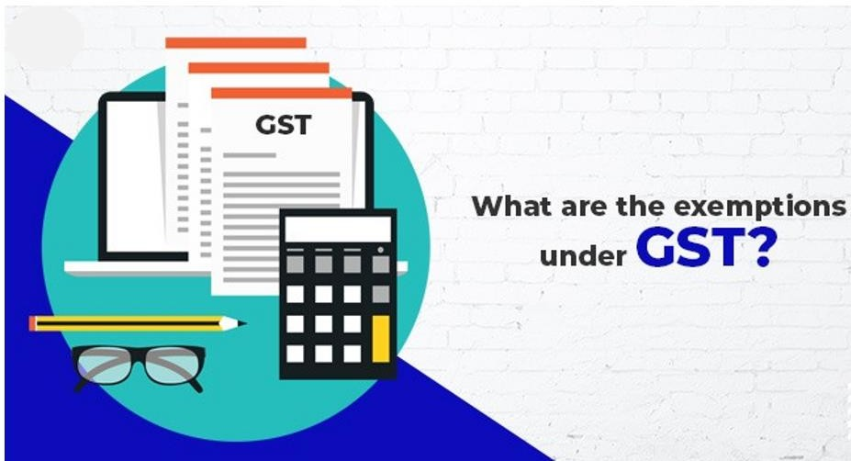
GST Exemption – Insurance Service

Slide 37
Exemptions relating to Insurance Business
Notification No.12/2017-Central Tax (Rate)] Dated: June 28, 2017
In exercise of the powers conferred by sub-section (3) and sub-section (4) of section 9, sub-section (1) of section 11, sub- section (5) of section 15 and section 148, of CGST Tax Act, 2017, the Central Government, on being satisfied that it is necessary in the public interest so to do, on the recommendations of the Council, hereby exempts the intra-State supply of services of description as specified in column (3) of the Table below from so much of the central tax leviable thereon under sub-section (1) of section 9 of the said Act, as is in excess of the said tax calculated at the rate as specified in the corresponding entry in column (4) of the said Table, unless specified otherwise, subject to the relevant conditions as specified in the corresponding entry in column (5) of the said Table, namely:-
Sl. No.
Chapter Description of Services Rate (pe Condition
heading r cent.)
28 Heading 9971 or Heading
9991
Services of life insurance business provided by way of annuity under the National Nil Nil
Pension System regulated by the
Pension Fund Regulatory and Development Authority of India under the Pension Fund Regulatory and Development Authority Act, 2013 (23 of 2013).
29 Heading 9971 or
Heading 9991
Services of life insurance business provided or agreed to be provided by the Army, Naval and Air Force Group Insurance Funds to members of the Army, Navy and Air Force, respectively, under the Group Insurance Schemes of the Central Government.
Nil
Nil

Slide 38
Exemptions relating to Insurance Business
Notification No.12/2017-Central Tax (Rate)] Dated: June 28, 2017
Sl. No. | Chapter heading | Description of Services | Rate (pe r cent.) | Condition
29A | Heading 9971 or 9991 | Services of life insurance provided or agreed to be provided by the Naval Group Insurance Fund to the personnel of Coast Guard under the Group Insurance Schemes of the Central Government. Inserted by Noti. No.02/2018 dated 25-01-2018 | Nil | Nil
29B | Heading 9971 or 9991 | Services of life insurance provided or agreed to be provided by the Central Armed Police Forces (under Ministry of Home Affairs) Group Insurance Funds to their members under the Group Insurance Schemes of the concerned Central Armed Police Force. Inserted by NN.21/2019 dated 30.09.2019 w.e.f. 01.10.2019 | Nil | Nil
30 | Heading 9971 or 9991 | Services by the Employees’ State Insurance Corporation to persons governed under the Employees’ State Insurance Act, 1948 (34 of 1948). | Nil | Nil

Slide 39
Exemptions relating to Insurance Business
Notification No.12/2017-Central Tax (Rate)] Dated: June 28, 2017
Sl. No.
Chapter
heading
`
Rate (pe Condition
r cent.)
35 Heading 9971 or Heading
9991
Services of general insurance business provided under following schemes –
Hut Insurance Scheme;
Cattle Insurance under Swarnajaynti Gram Swarozgar Yojna
Scheme for Insurance of Tribals;
Janata Personal Accident Policy and Gramin Accident Policy;
Group Personal Accident Policy for Self-Employed Women;
Agricultural Pumpset and Failed Well Insurance;
premia collected on export credit insurance;
Restructured Weather Based Crop Insurance Scheme (RWCIS)], Government of India and implemented by the Ministry of Agriculture;
Jan Arogya Bima Policy;
[Pradhan Mantri Fasal BimaYojana (PMFBY)];
Pilot Scheme on Seed Crop Insurance;
Central Sector Scheme on Cattle Insurance;
Universal Health Insurance Scheme;
Rashtriya Swasthya Bima Yojana;
Nil Nil
approved by the
(o) Coconut Palm Insurance Scheme; (p) Pradhan Mantri Suraksha BimaYojna;
(q) Niramaya Health Insurance Scheme implemented by the Trust [(r) Bangla Shasya Bima]

Slide 40
Exemptions relating to Insurance Business
Notification No.12/2017-Central Tax (Rate)] Dated: June 28, 2017
Sl. No. | Chapter heading | Description of Services | Rate (pe r cent.) | Condition
36 | Heading 9971 or Heading 9991 | Services of life insurance business provided under following schemes- Janashree Bima Yojana; Aam Aadmi Bima Yojana; Life micro-insurance product as approved by the Insurance Regulatory and Development Authority, having maximum amount of cover of [two lakhs] rupees; Varishtha Pension BimaYojana; Pradhan Mantri Jeevan Jyoti BimaYojana; Pradhan Mantri Jan DhanYogana; Pradhan Mantri Vaya Vandan Yojana. 48. Subs. by Noti. No.02/2018 dated 25-01-2018 for "fifty thousand" | Nil | Nil
36A | Heading 9971 or 9991 | Services by way of reinsurance of the insurance schemes specified in serial number 35 or 36 ⁵⁰[or 40]. | Nil | Nil]

Slide 41
Exemptions relating to Insurance Business
Notification No.12/2017-Central Tax (Rate)] Dated: June 28, 2017
Sl. No. | Chapter heading | Description of Services | Rate (pe r cent.) | Condition
39 | Heading 9971 or 9985 | Services by the following persons in respective capacities – business facilitator or a business correspondent to a banking company with respect to accounts in its rural area branch; any person as an intermediary to a business facilitator or a business correspondent with respect to services mentioned in entry (a); or business facilitator or a business correspondent to an insurance company in a rural area. | Nil | Nil

Slide 42
Exemptions relating to Insurance Business
Notification No.12/2017-Central Tax (Rate)] Dated: June 28, 2017
Sl. No.
Chapter heading
Description of Services
Rate (pe Condition
r cent.)
39A Heading 9971
Services by an intermediary of financial services located in a multi services SEZ with International Financial Services Centre (IFSC) status to a customer located
Nil Nil]
outside India for international financial services in currencies other than Indian
rupees (INR).
Explanation.- For the purposes of this entry, the intermediary of financial services in IFSC is a person,-
who is permitted or recognised as such by the Government of India or any
Regulator appointed for regulation of IFSC; or
who is treated as a person resident outside India under the Foreign Exchange Management (International Financial Services Centre) Regulations, 2015; or
who is registered under the Insurance Regulatory and Development Authority of India (International Financial Service Centre) Guidelines, 2015 as IFSC Insurance Office; or
who is permitted as such by Securities and Exchange Board of India (SEBI) under the Securities and Exchange Board of India (International Financial Services Centres) Guidelines, 2015.

Slide 43
Exemptions relating to Insurance Business
Notification No.12/2017-Central Tax (Rate)] Dated: June 28, 2017
Sl. No. | Chapter heading | Description of Services | Rate (pe r cent.) | Condition
40 | Heading 9971 or 9991 | Services provided to the Central Government, State Government, Union territory under any insurance scheme for which total premium is paid by the Central Government, State Government, Union territory. | Nil | Nil
2. Definitions. - For the purposes of this notification, unless the context otherwise requires, -
(zb) “general insurance business” has the same meaning as assigned to it in clause (g) of section 3 of the General Insurance Business (Nationalisation) Act, 1972 (57 of 1972);
(zj) “insurance company” means a company carrying on life insurance business or general insurance business;
(zn) “life insurance business” has the same meaning as assigned to it in clause (11) of section 2 of the Insurance Act, 1938 (4 of 1938)
(zo) “life micro-insurance product” shall have the same meaning as assigned to it in clause (e) of regulation 2 of the
Insurance Regulatory and Development Authority (Micro-insurance) Regulations, 2005;

Slide 44
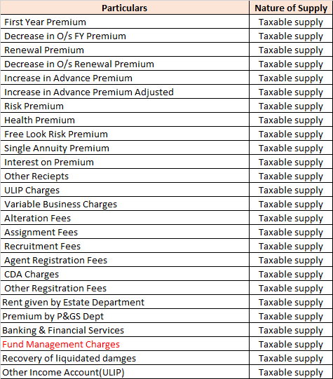
Breakup of Revenue

Slide 45
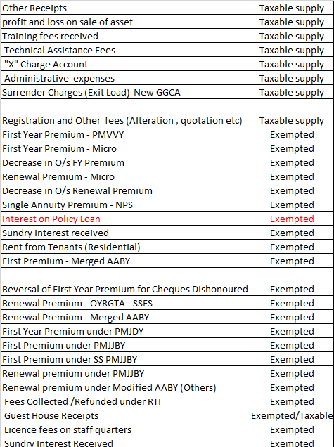

Slide 46
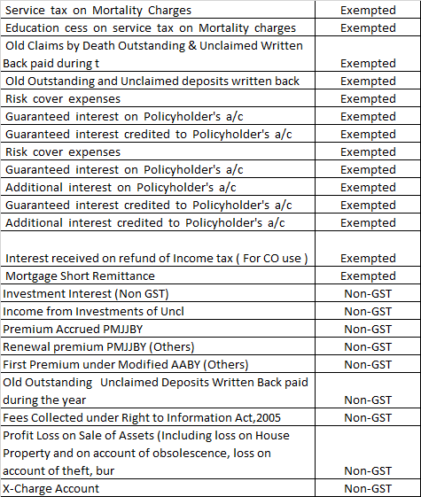

Slide 47
Builders & Developers

Slide 50
Sr. No. | Types of Collection | Taxability under GST regime
1. | Parking space charges | Taxable as composite supply
2. | Prime/Preferential charges for unit choice. | Taxable as a composite supply
3. | Floor wise extra charges Floor Rise | Taxable as a composite supply
4. | Amenity/ Common infrastructure development charges. | Taxable as a composite supply
5. | Club Membership | Separately Taxable at Full rate

Slide 51
6. | Advocate/Legal Charges | Separately Taxable at Full rate
7. | Modification charges | Separately Taxable at Full rate
8. | Interest/Late Fee/Penalty on delayed collection | Separately Taxable at Full rate
9. | Booking Cancellation charges | Separately Taxable at Full rate
10. | Maintenance deposits | Separately Taxable at Full rate
 | Total receipt collected under above heads

Slide 52
Intermediary Service provider:
 | Grounds for disallowance of claim of Export of Servcies
Definition of Intermediary | Section 2(13) of the IGST Act,2017
Place of Supply | Section 13 (8) (b) of the IGST Act,2017
AAR | Vserve Global Private Limited (Maharashtra) Global Reach Education Service Pvt Ltd (West Bengal ) Airbus India (Karnataka)
High Court Rulings | 1) Material Recycling Association of India v.Union of India –Hon.Gujarat High Court upheld the constitutional validity of section 13(8)(b) of the IGST Act,2017
CBIC Circular | Circular no.159/15/2021-GST dated 20/09/2021 which dealt with Scope of Intermediary Services Primary Requirements of Intermediary Services:- a) Minimum Three Parties b) Two Distinct Supplies c) Intermediary service provider to have the character of an agent, broker or any other similar person d) Does Not include a person who supplies such goods or services or both or securities on his own account e) Subcontracting for a service is not an intermediary service

Slide 53
Article 3 Services The Affiliate may render the following services (tick the box): (....) Operations This service consists of the release and the deployment of products, solutions and standards as well as of the day-to-day monitoring and controlling of systems and networks and the management and maintenance of the Operating centres. Sales Support, Education & Consulting This service consists of the Affiliate to manage and develop the commercial relationship with SWIFT's customers. More specifically, it includes the following activities: relationship and account management capabilities, promotion and marketing of SWIFT product and services, organisation of local events, delivery of education and consulting services (ie. trainings, presentations, consulting services) to customers, delivery of services that support customers to implement best practice enhancements to their infrastructure & processes, to leverage the use of SWIFT products and services and to represent SWIFT throughout a specified territory. The Affiliate agrees to promote and market SWIFT products and services in accordance with the applicable standard terms and conditions and not to take any initiative or to commit SWIFT towards any third-party without SWIFT's prior approval.

Slide 54
Ordering and Customer Support This service aims at ensuring that customers have the necessary administrative, operational and technical help to effectively use SWIFT product and services. It also includes the collection and the processing of customer orders, the first line and second line helpdesk support, offering a continuous 7/24 service. General Support This service consists of supporting day-to-day activities which are not specified to SWIFT core business.

Slide 55
Article 4 Service fee The Parties agree to apply the Cost Plus Method to determine an arm's length remuneration for the Services provided. On a monthly basis, the Affiliate will issue an invoice to SWIFT based on the below computation: Service fee = + (Cost Base* (1 + Mark-up)) - (Fees invoiced locally) +(Foreign exchange costs - Foreign exchange income) + (Interest costs - Interest income) +(Exceptional costs - Exceptional income) This Service fee will be expressed in the Affiliate's local currency and computed based on IFRS accounting standards.

Slide 56
Conclusion :-Intermediary Services Careful reading of Agreement of provision of Services Definition of Export of Services-section 2(6) of IGST Act Place of Supply of Services:- Outside India ??? Definition of Intermediary :-Section 2 (13) of IGST Act Key terms:- • Means • Broker, agent or any other person, by whatever name called • Who arranges or facilitates the supply of goods or services or both, or securities, • Between two or more persons, • But does not include a person who supplies such goods or services or both or securities on his own account

Slide 57
Thank You

