Slide 1

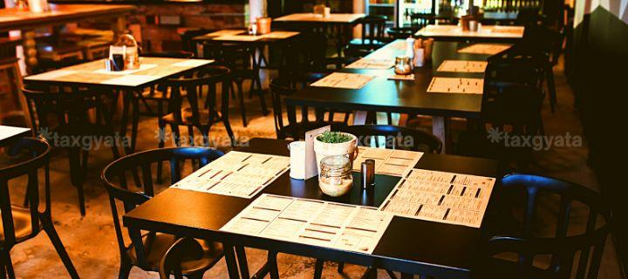
SINCE 1980
GST ON RESTAURANT SERVICES

Slide 2

RESTAURANT SERVICES
“Restaurant Service” means supply, by way of or as part of any service, of goods, being food or any other article for human consumption or any drink, provided by a restaurant, eating joint, including mess, canteen, whether for consumption on or away from the premises where such such food or any other article for human consumption or drink is supplied.

Slide 3
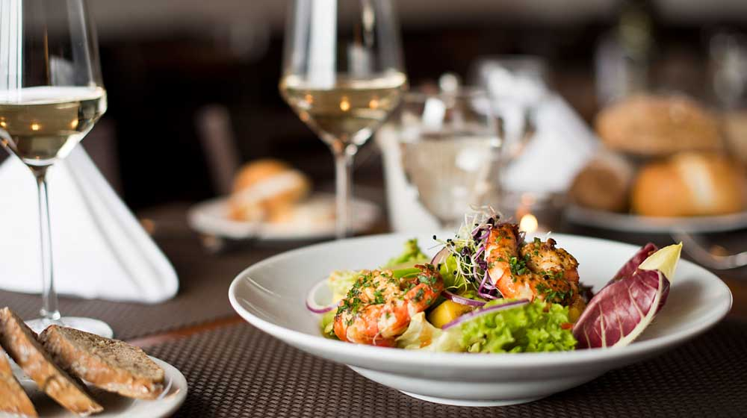
Restaurant services includes services provided by Restaurants, Cafes and similar eating facilities including takeaway services, room services and door delivery of food.
Therefore, it is clear that takeaway services and door delivery services for consumption of food are also considered as restaurant service and, accordingly, service by an entity, by way of cooking and supply of food, even if it is exclusively by way of takeaway or door delivery or through or from any restaurant would be covered by restaurant service. This would thus cover services provided by cloud kitchens/central kitchens.

Slide 4

RATE OF TAX ON RESTAURANT SERVICES

Slide 5
S No | Type of Restaurants | GST Rate
1 | Food supplied or catering services by Indian Railways/IRCTC | 5% without ITC
2 | Standalone restaurants, including takeaway | 5% without ITC
3 | Standalone outdoor catering services or food delivery service | 5% without ITC
4 | Restaurants within hotels (Where room tariff is less than Rs 7,500) | 5% without ITC
5 | Normal/composite outdoor catering within hotels (Where room tariff is less than Rs 7,500) | 5% without ITC
6 | Restaurants within hotels* (Where room tariff is more than or equal to Rs 7,500) | 18% with ITC
7 | Normal/composite outdoor catering within hotels* (Where room tariff is more than or equal to Rs 7,500) | 18% with ITC

Slide 6
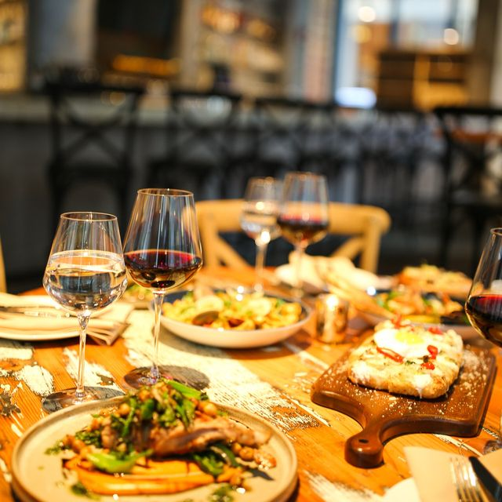

GST composition scheme for restaurants
Restaurants are required to pay GST at a concessional rate of 5% on the turnover under the composition scheme subject to the following restrictions
* Turnover not to exceed Rs 1.5 Crores (Rs 1 Crore in case of special category States)
Should not be engaged in any services other than a restaurant
* Restaurants cannot make interstate outward supply of goods
* Cannot supply any items not taxable under GST such as alcohol.
* They cannot supply goods through an e-commerce operator
* Restaurants cannot avail any input tax credit
* They cannot collect taxes from the customer

Slide 7
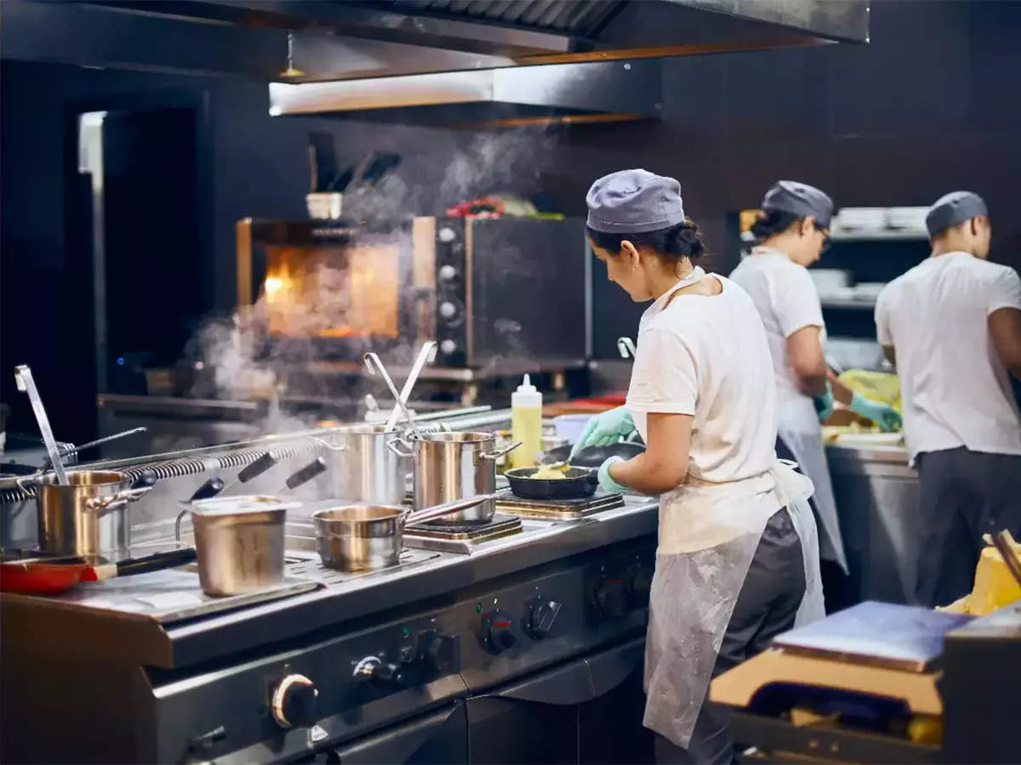
Tax Evasion practices and checks

Slide 8
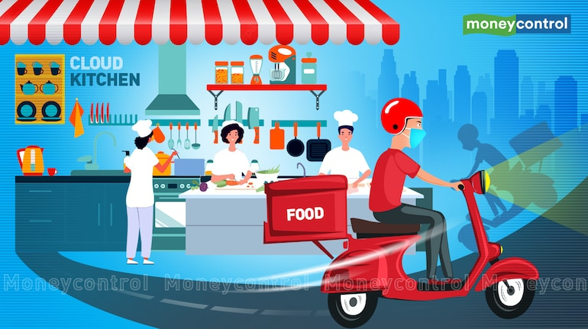
Claim of ITC
Restaurant services are generally taxable @5% without ITC. Apart from food Several general items are sold by restaurant for which they raise Tax invoices as per relevant rate of tax for which they can claim ITC. The rest of ITC needs to get reversed which is not properly reversed by Taxpayer.
In the above mentioned cases the service provider has to issue separate tax invoice than that for restaurant services which is generally not issued . These details are required to be asked.
A separate inventory of goods used in food preparation and the goods which are sold separately should be kept by service provider. During the investigation ascertainment of goods used in food preparation should be done.

Slide 9


Composite or mixed supply
Supplies through ECO
Franchise issue
In several mithai cum restaurant shops, eatables are sold as gift hampers containing various different tax rates. These gift hampers should be taxed at the rate of commodity with highest rate of tax present in them but generally the sellers tax the items separately.
An e-commerce operator has to pay tax on supply of restaurant services through e-commerce operator, the facility of ITC is not available on such items. The claim of ITC on supplies made through ECO should be checked.
On supply of goods other than food, the tax needs to get paid by the service provider and not by ECO.
There are several restaurants chains which operate on franchise basis. Transfer of franchise rights is different service which is taxable @18% . It should be checked that whether or not the tax has been paid on these services.

Slide 10
Stock
Separate bills
Food safety regulations make it mandatory to mention the expiry date of food items on bills issued by service provider. This factor should be considered in calculation of turnover for the items meant for over the counter sale .
Similarly the expiry date of raw materials used in food preparation should be considered while deciding the turnover for cooked foods.
The ECO is required to issue separate tax invoices for supply of restaurant services and for supply of other items.
For the items other than cooked food, tax should be paid at relevant tax rate for such item.

Slide 11
Liability on sale by URD
Tax deposition in cash
In cases where the unregistered restaurants make supply through ECO, the ECO is liable to pay tax on such supplies. The registration of actual supplier has no impact on ECO liability.
Tax liability on supply of restaurant services through ECO should necessarily be discharged in cash.

Slide 12
THANK YOU…

